Slide 1
Process Documentation of Secure Bank Cloud-Native Serverless Online Banking System

Slide 2
Services used for Project
1.AWS Lambda
1.Triggers
2.Cloud Watch Logs
2.S3 (Simple Storage Service)
1.Bucket
3.AWS RDS
1.Database
2.CloudWatch Metrics ,Logs & Events
4.Dbeaver(To Display data in RDS)

Slide 3
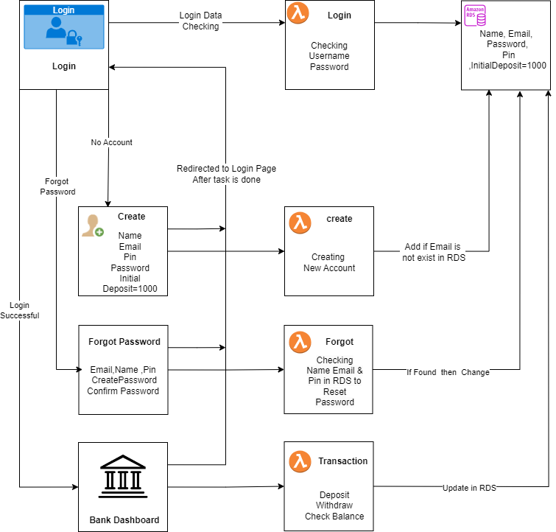
Flowchart of the Project

Slide 4
1.Sign-in to AWS Root Account
1.Search for AWS Management Console in Browser.
2.Open to the AWS Management Console.
3.Click on “Sign In to the Console”.
4.Choose “Root user” as the login method.
5.Enter Email and Password that is associated with your AWS root account.
6.Click on Sign in.

Slide 5
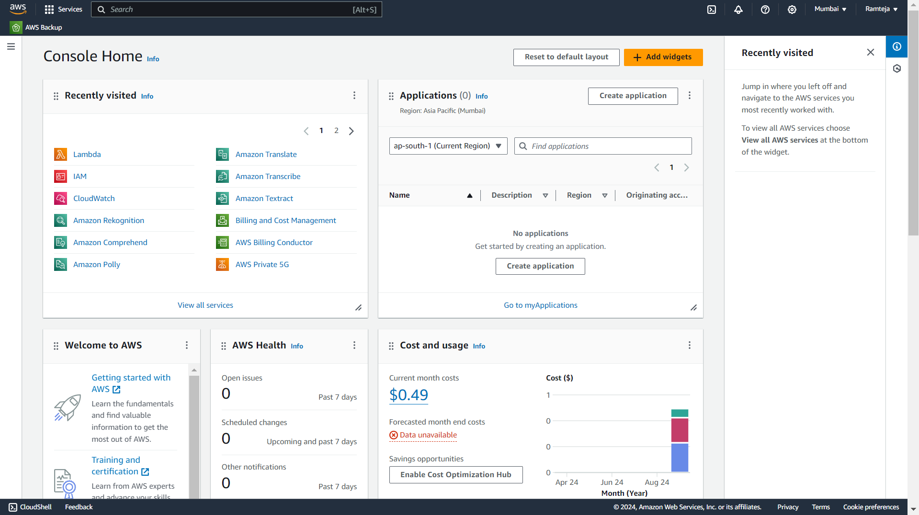
1.1 AWS Console Home.

Slide 6
2.SettingUp Lambda
1.Search for Lambda in Search bar and open Lambda dashboard.
2.Click on Create Lambda Function , Assign a Name to Lambda & Runtime(Language) , Select Architecture as x86_64 , Click on Create a new role with basic lambda Permissions , Create.
3.Click on Add Trigger , Search for API Gateway , in intent block - checkmark on Create new API , in API type block select REST API , in Security dropdown select Open and Add it.
4.Click on Code in Lambda Function , Click on Upload from , select the ZIP file ,click on “Upload to” Upload the zip file in Lambda function & the code will be Deployed if not Click on Deploy.
5.Click on Configuration in Lambda Function to get API Endpoint & Copy it.
6.Open VScode, Paste the API Endpoint in JavaScript code , Open the website ,enter the data that has to send to Lambda & , Click on the button to Hit a request to Lambda Via API Gateway from website.

Slide 7
7.Click on Monitor in Lambda Function ,Click on view Cloud Watch Logs & Open Log groups – “aws/lambda/lambda_name” to watch the logs of the created Lambda Function.
8.We can see the logs of Hitting Request to Lambda via API Gateway from Website of Local Host.
9.When we hit a request from Website to lambda through API Gateway’ end point then API Gateway will receive a request from Website with data & that came in raw body to Lambda Function.

Slide 8
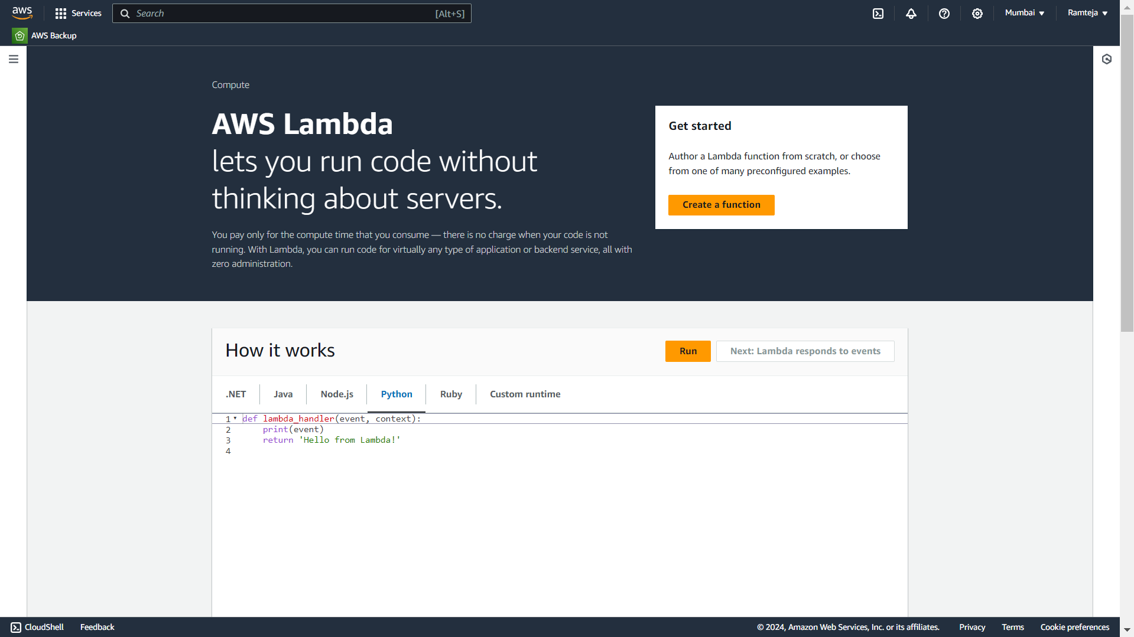
2.1 AWS Lambda Dashboard, Click on Create a function.

Slide 9
2.1 SettingUp Createlambda
Use of Create Lambda:
1.It is used to take the data of creation of an account from website to AWS Lambda.
2.If any data is missed then it returns missing data field.
3.It Takes data Full Name, Email, Pin, Password, Initial Deposit when create button is clicked it send data to AWS Lambda then lambda connects to RDS.
4.Full Name is must filled field, if Email entered already exits it returns account already created with this email& email should be in xxxx@gmail.com format, pin should be 4 digits, initial deposit should be minimum ₹1000 or more , Password should contain 8 characters with consists of 1 Capital[A-Z], 1 Small letter[a-z], 1 Number[0-9], & a special character[@,$,&,*,!].
5.AWS Lambda sends the data to AWS RDS database & stores the data in the table.
6.If all done without any error then it will return Account Created Successfully in the Website.
7.After creation of account it will direct to Login page.

Slide 10
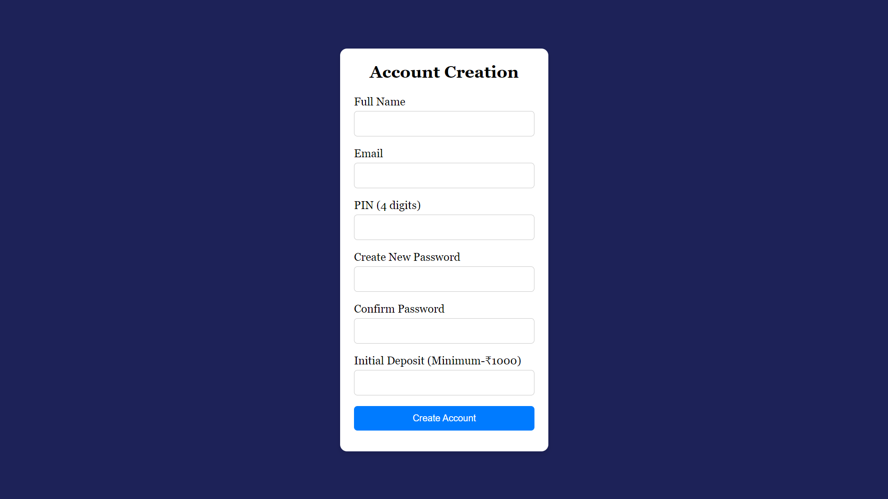
Create Account Page

Slide 11
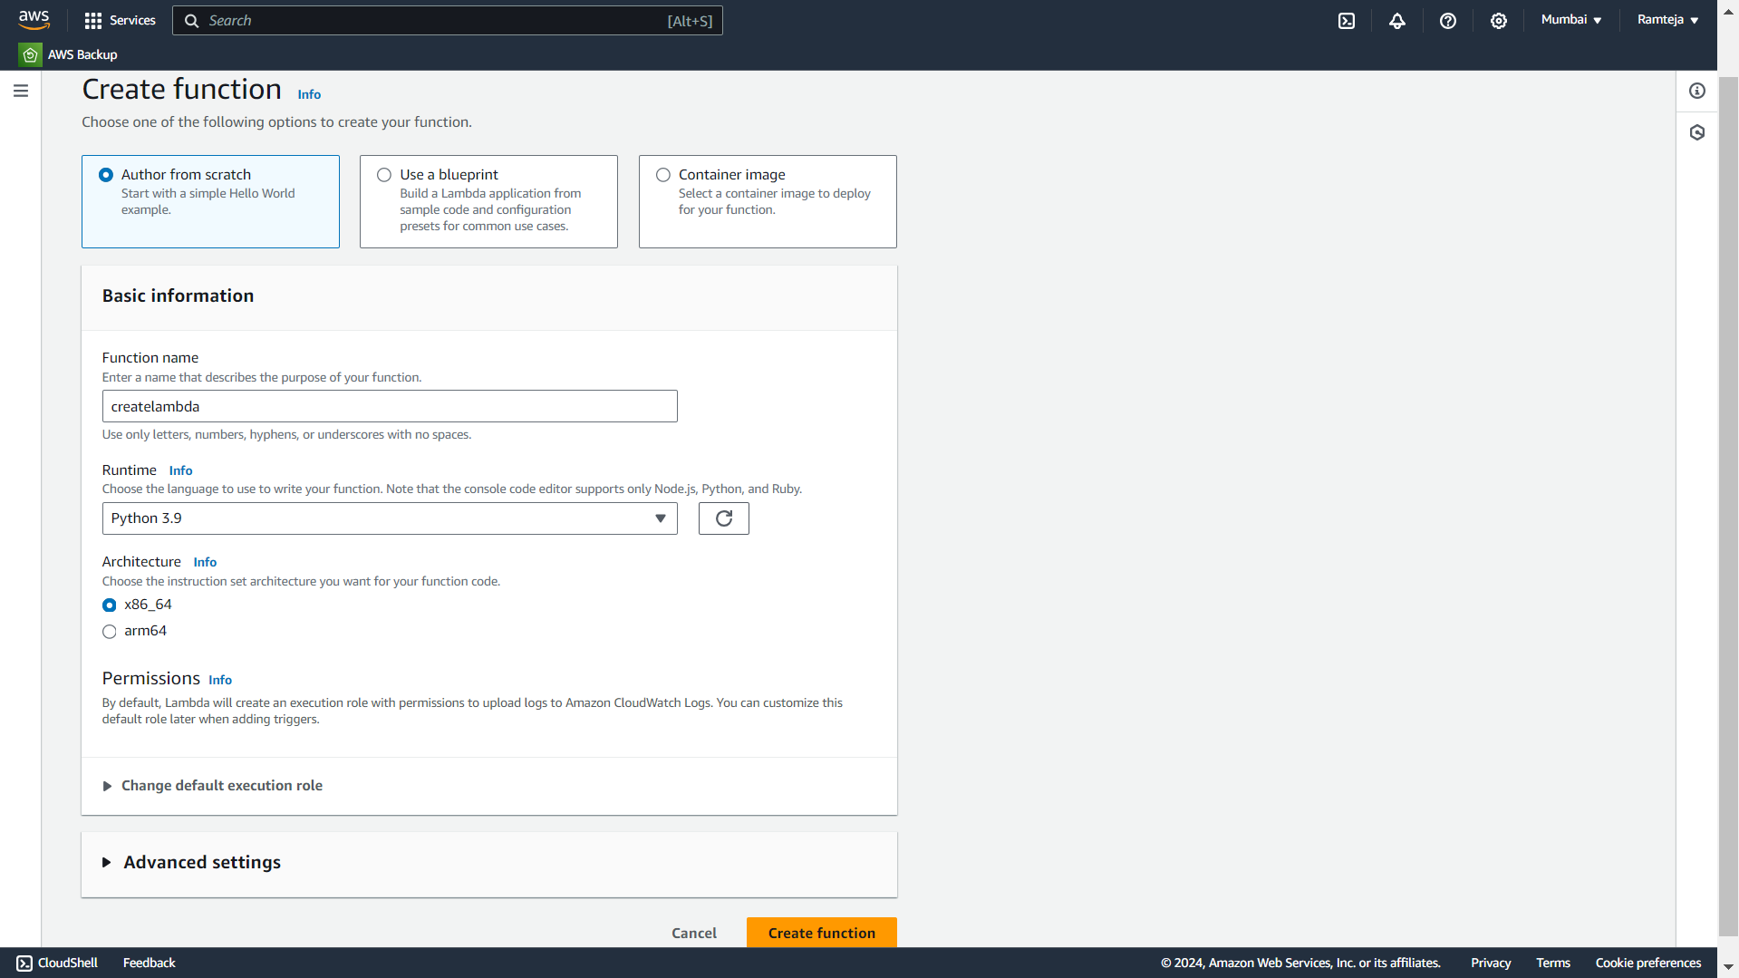
2.1.1 Create lambda function for Create Account page.

Slide 12
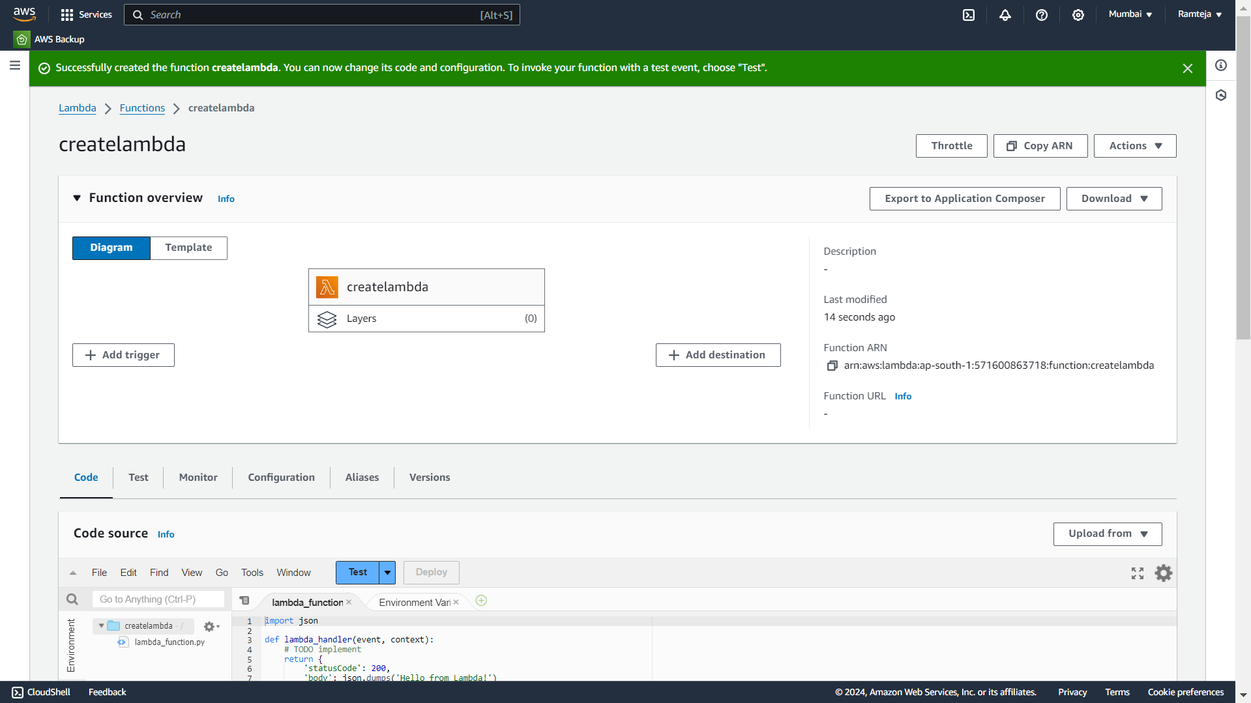
2.1.2 Lambda function “createlambda” is Created, Click on Add trigger.

Slide 13
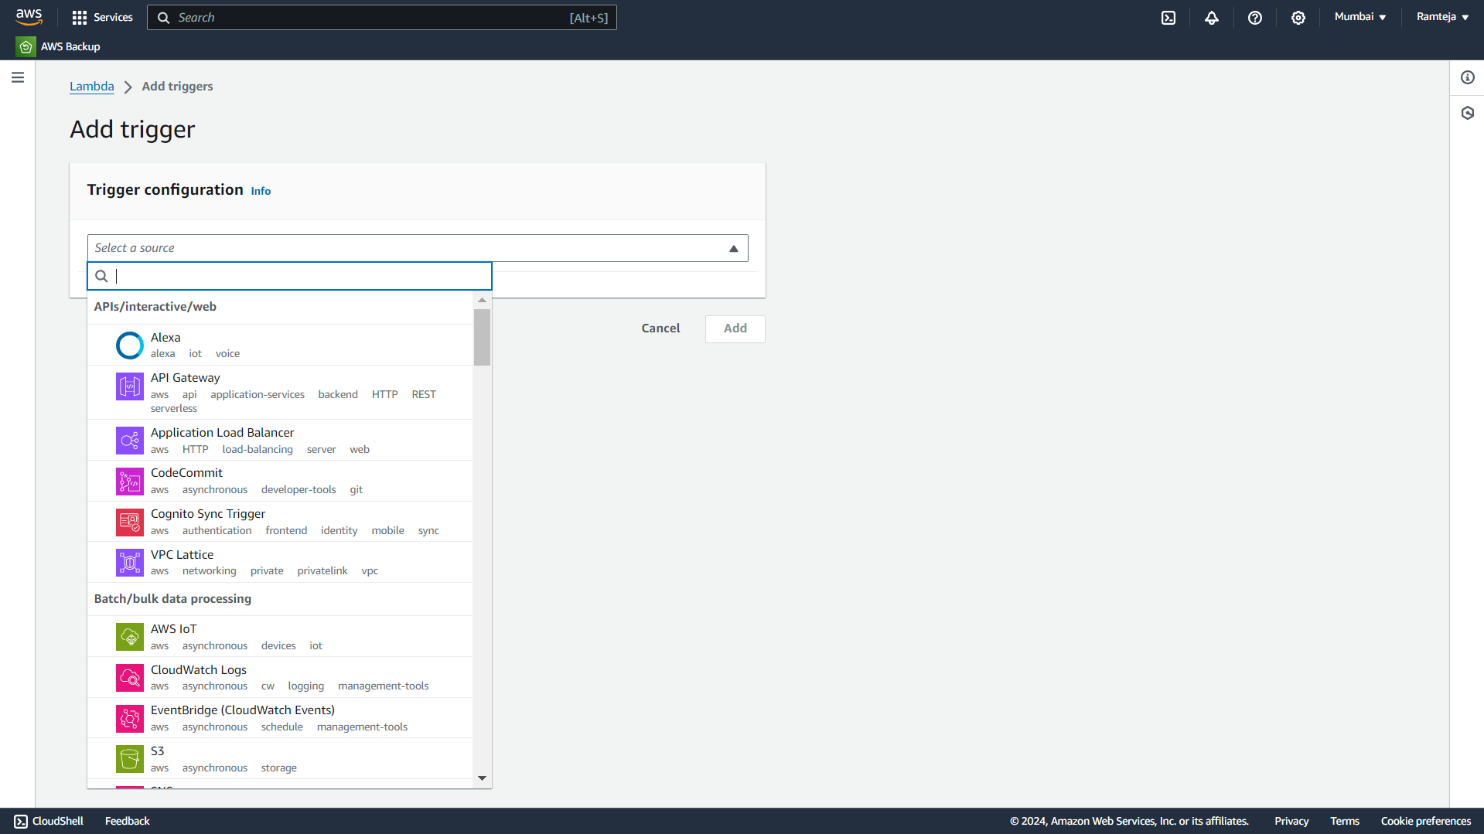
2.1.3 Click on API Gateway.

Slide 14
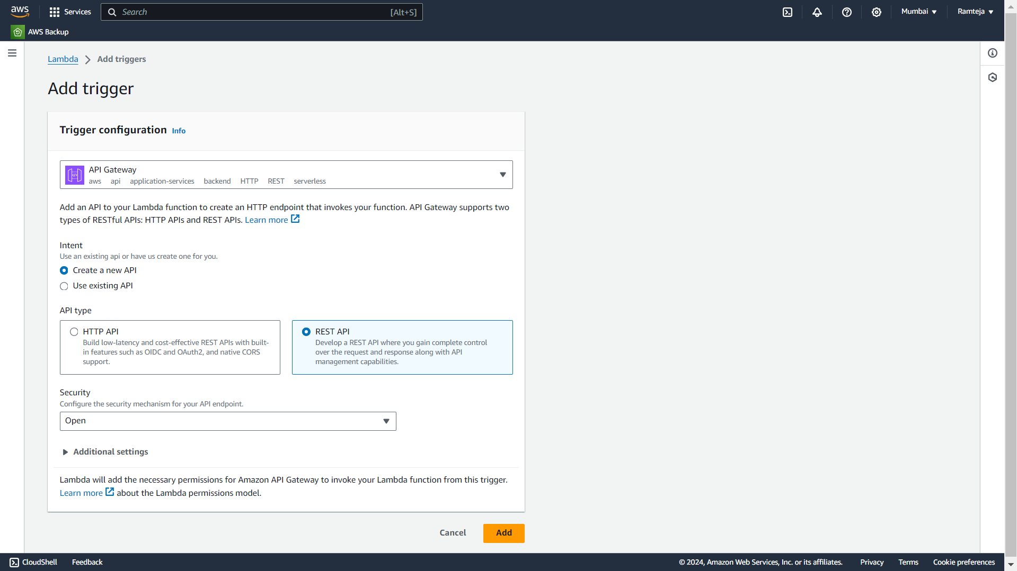
2.1.4 Follow the steps in Setting UpLambda.

Slide 15
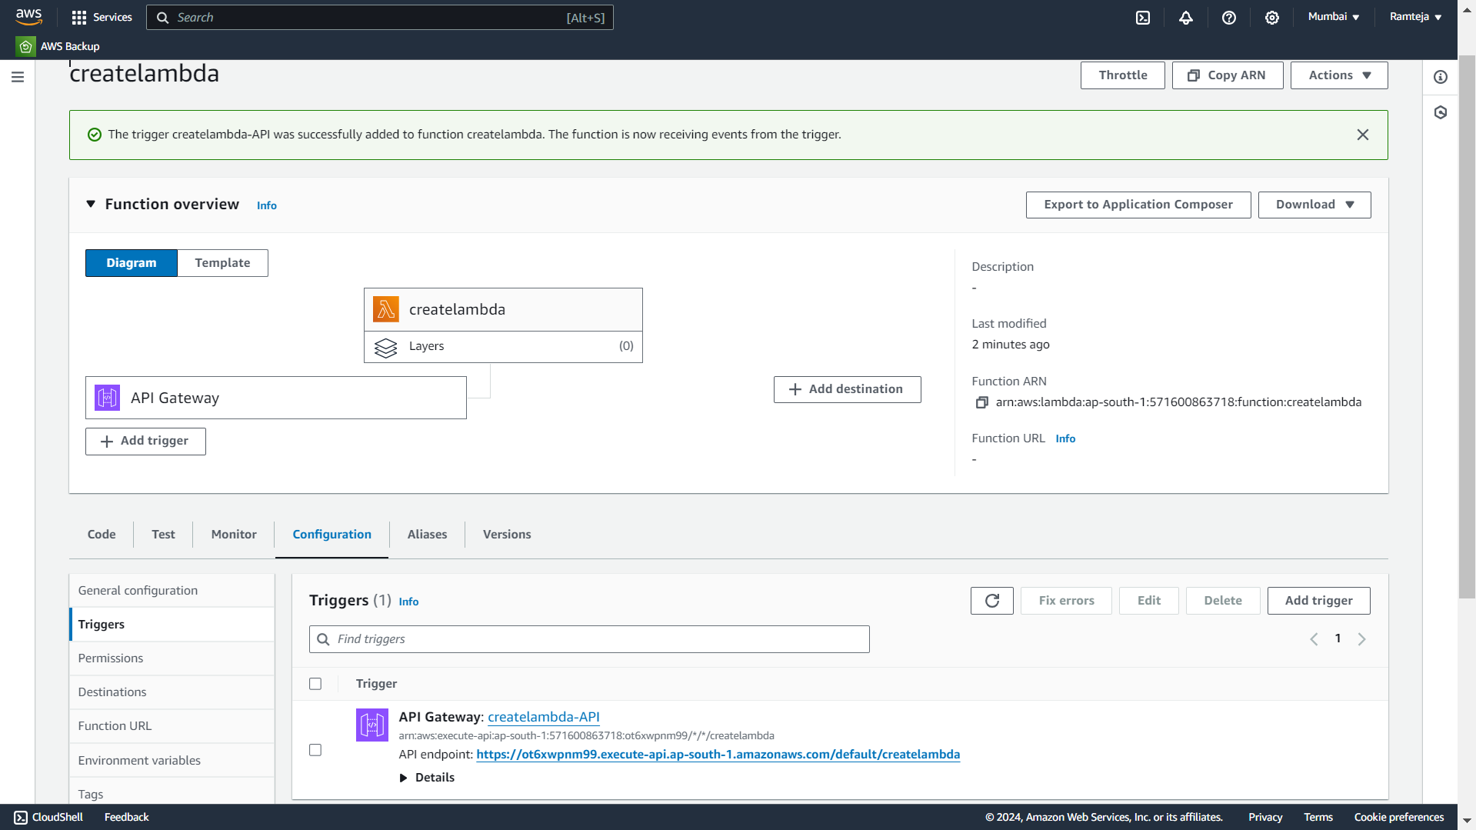
2.1.5 Open Configuration in Lambda Function to Copy API Gateway Url.

Slide 16
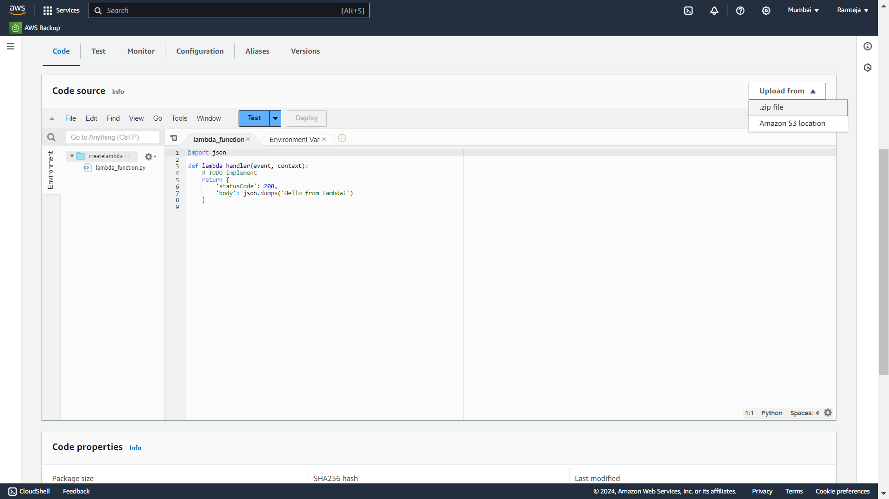
2.1.6 Click on Code & Upload Zip file in lambda function.

Slide 17
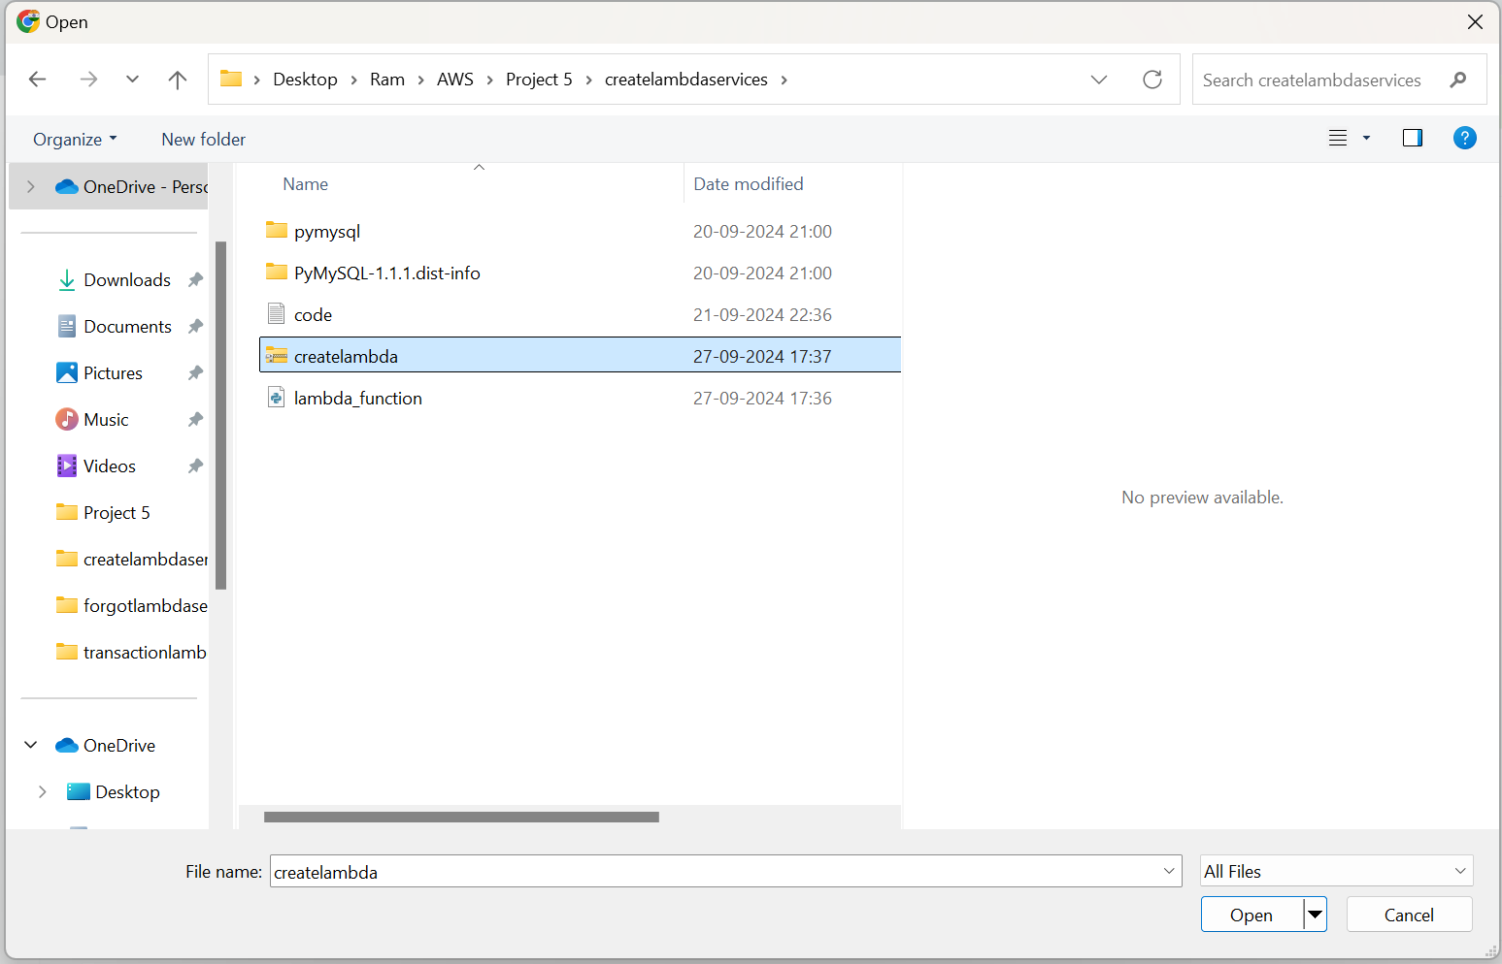
2.1.7 Choose Zip file.

Slide 18
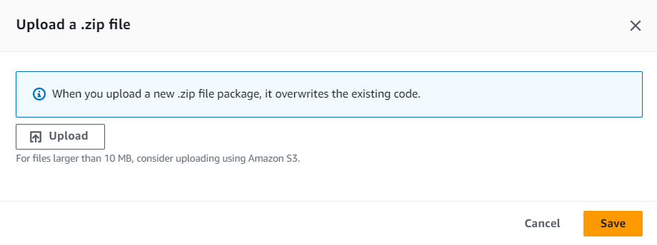
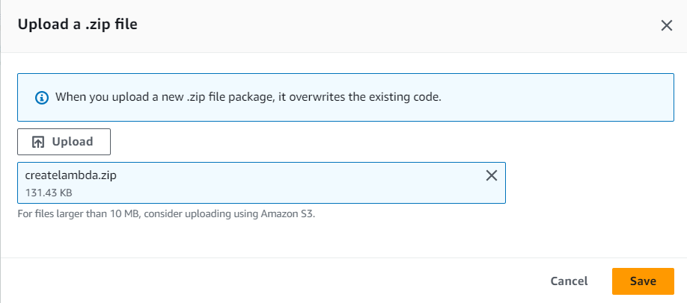

Slide 19
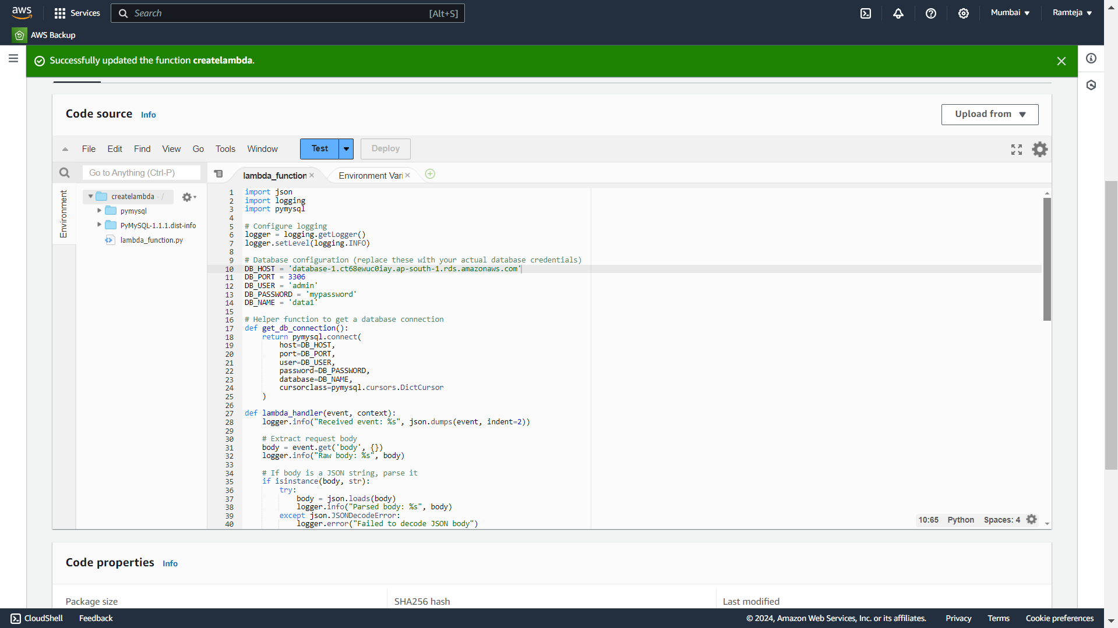
2.1.8 Code Uploaded Successfully.

Slide 20
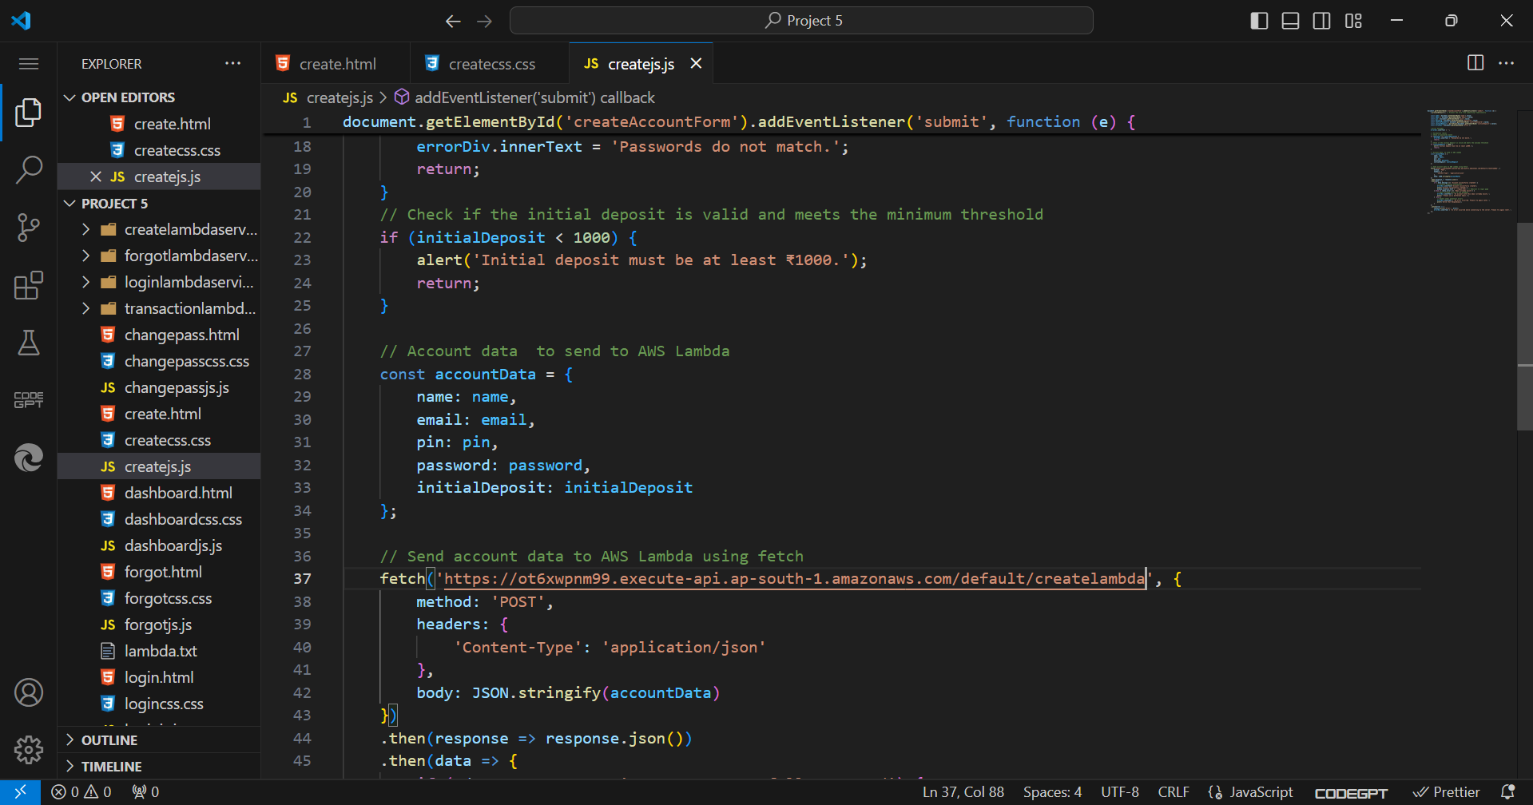
2.1.9 Paste the API Endpoint in JS Code of Create page.

Slide 21
2.2 SettingUp Loginlambda
Use of Login Lambda:
1.It is used to take the data of Login page from website to AWS Lambda.
2.If any data is missed it returns missing data field.
3.It Takes email & password, when login button is clicked it sends the data to AWS lambda & then lambda connects to RDS.
4.If email does not match in database then it returns Invalid Email.
5.If password doesn’t match in database for Corresponding email then it returns Invalid Password.
6.If both email & password are wrong then it returns Invalid Credentials.
7.In RDS ,it Checks if the email exists in database or not, if exists then checks the corresponding password, if both matches it is directed to dashboard of website.

Slide 22
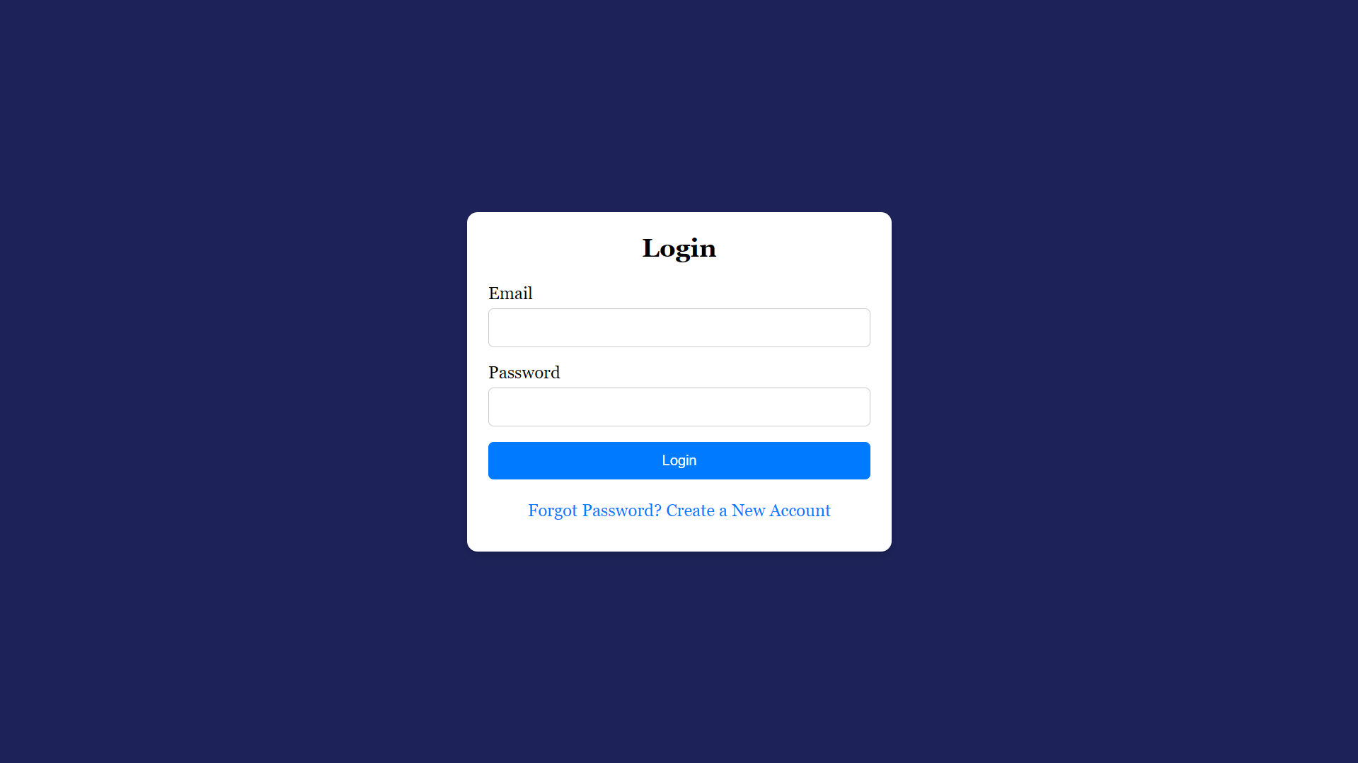
Login Page

Slide 23

2.2.1 Create lambda function for Login page.

Slide 24
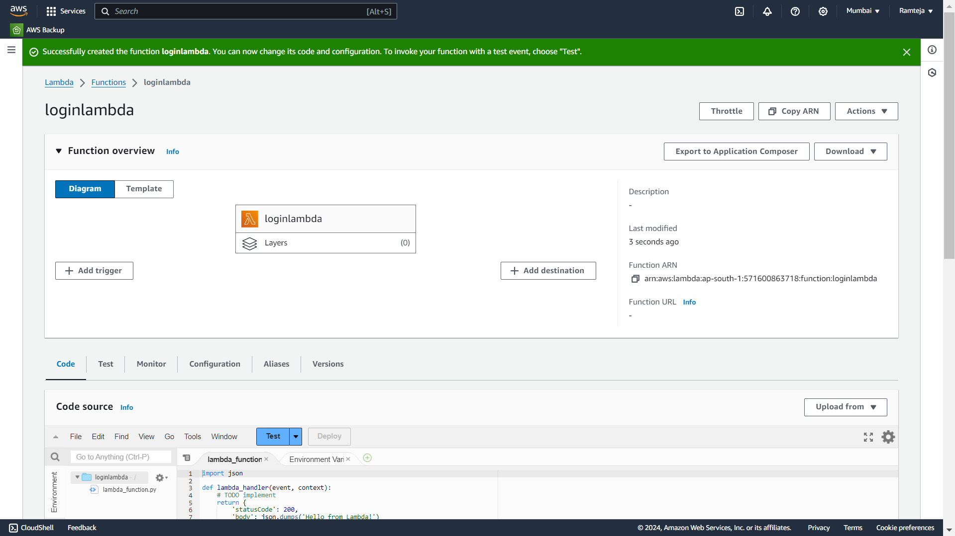
2.2.2 Lambda function “loginlambda” is Created, Click on Add trigger.

Slide 25
2.2.3 Click on API Gateway.

Slide 26
2.2.4 Follow the steps in Setting UpLambda.

Slide 27
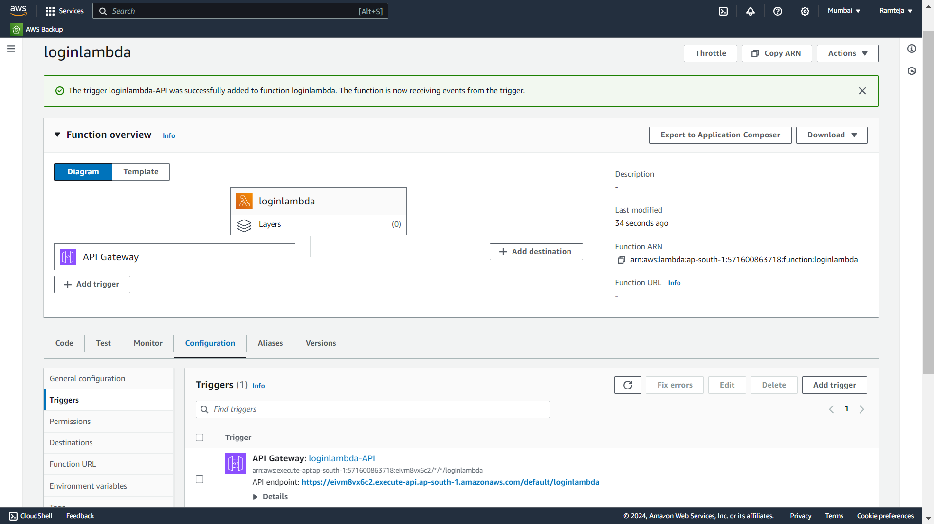
2.2.5 Open Configuration in Lambda Function to Copy API Endpoint Url.

Slide 28
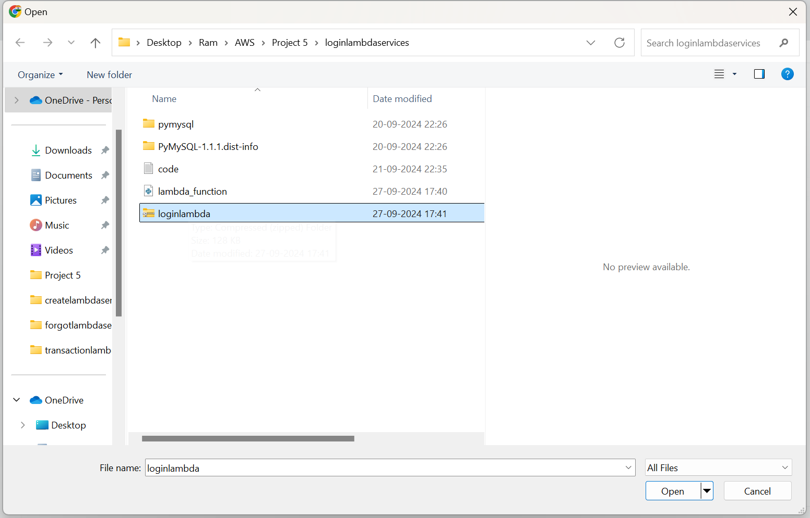
2.2.6 Choose Zip file.

Slide 29
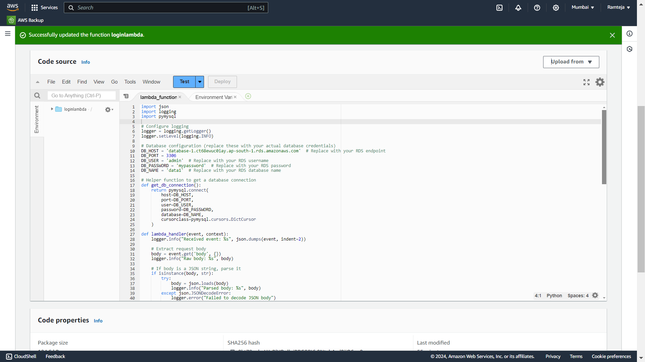
2.2.7 Code Uploaded Successfully.

Slide 30
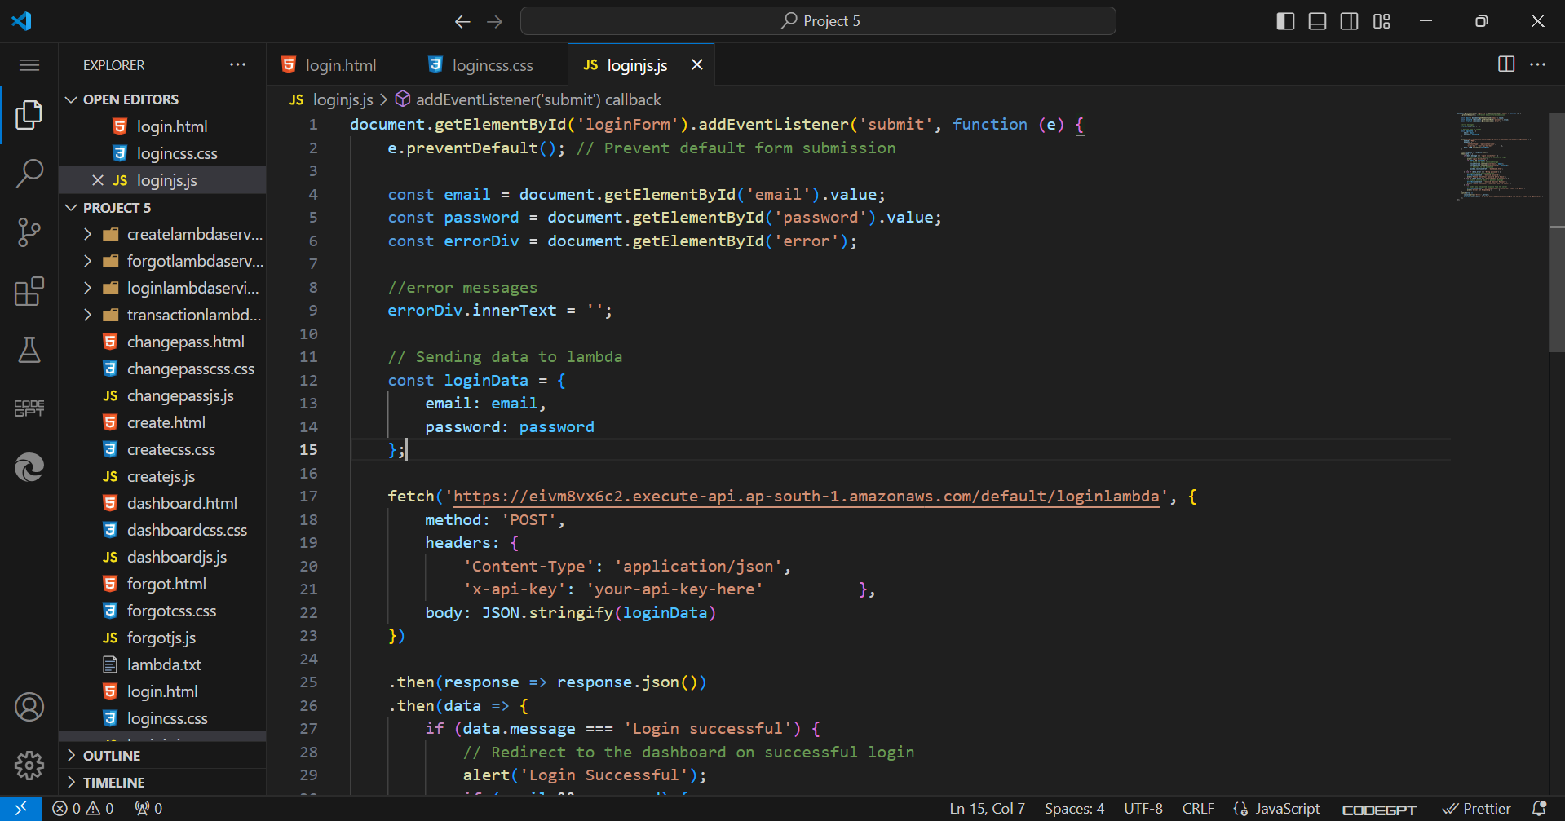
2.2.8 Paste the API Endpoint in JavaScipt Code of Login page.

Slide 31
2.3 Forgotlambda
Use of Login Lambda:
1.It is used to take the data of forgot page from website to AWS Lambda.
2.If any data is missed it returns missing data field.
3.It Takes data of email ,name, pin with new password & then sends to AWS lambda when submit button clicked then lambda connects to RDS.
4.If any of these doesn’t match in database then it returns data not found to website.
5.It first checks the email and then corresponding name and at last the corresponding pin, if all these three matches in the database the new password is replaced with old password in database.
6.It returns Password changed successfully for email to the website.

Slide 32
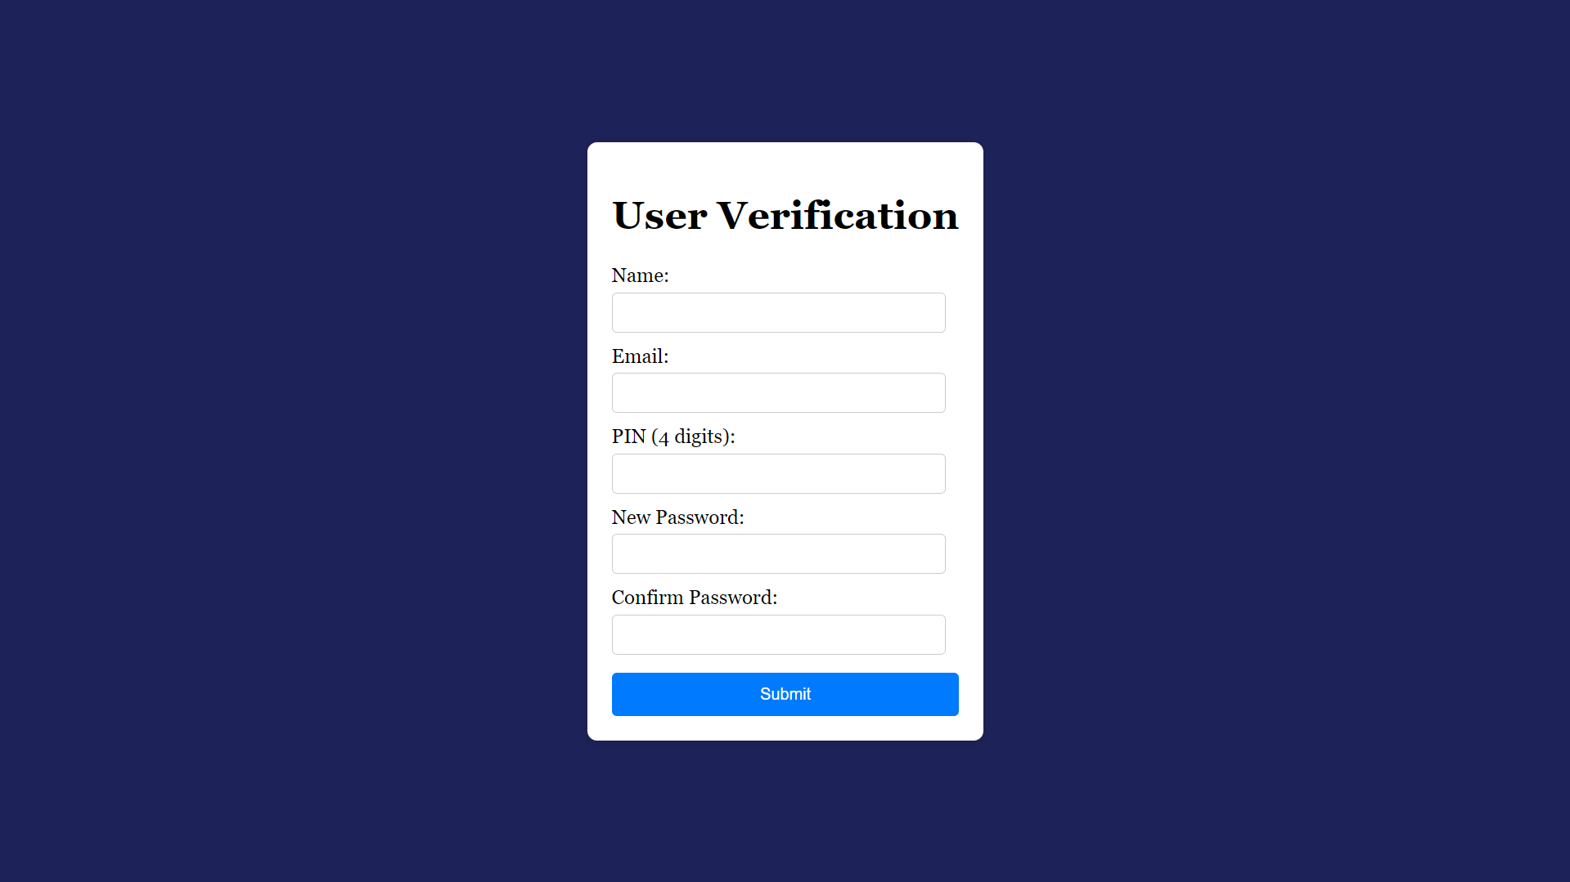
Forgot Password Page

Slide 33

2.3.1 Create lambda function for Reset Password page.

Slide 34

2.3.2 Lambda function “forgotlambda” is Created, Click on Add trigger.

Slide 35
2.3.3 Click on API Gateway.

Slide 36
2.3.4 Follow the steps in Setting UpLambda.

Slide 37

2.3.5 Open Configuration in Lambda Function to Copy API Gateway Url.

Slide 38

2.3.6 Choose Zip file.

Slide 39
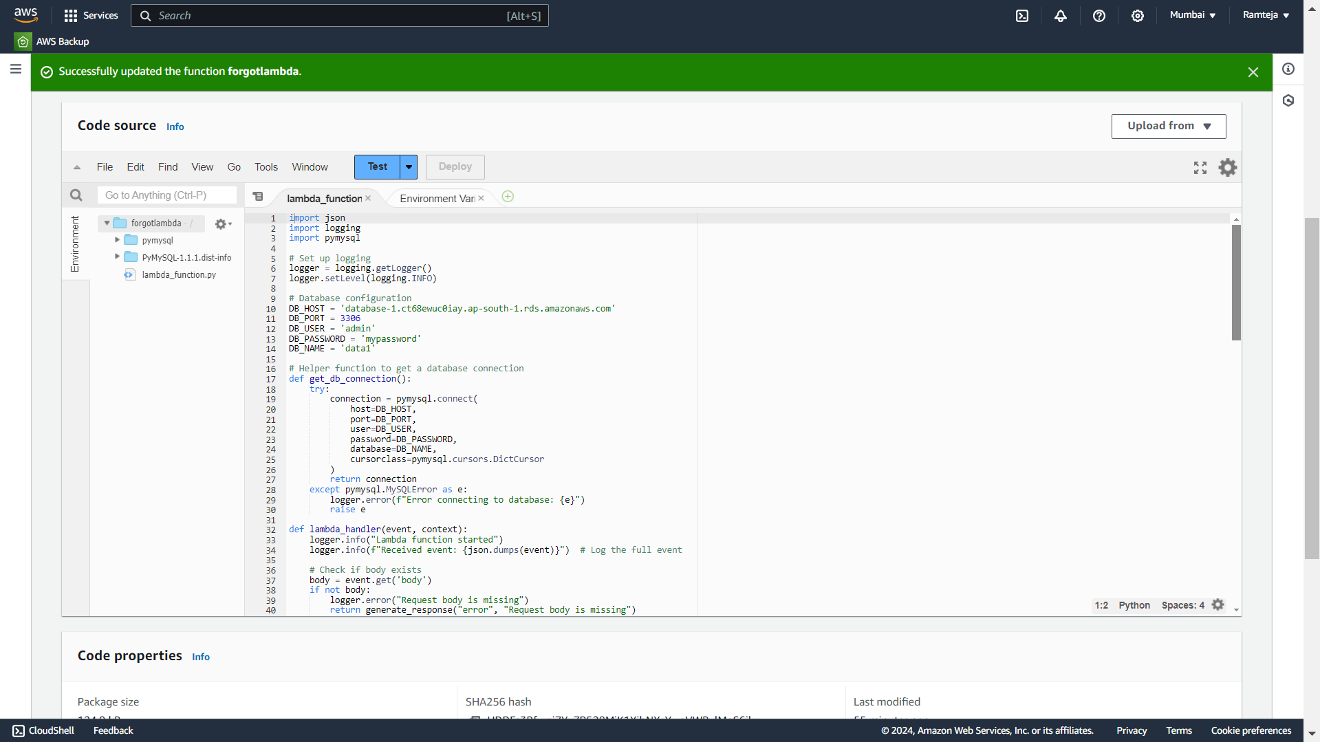
2.3.7 Code Uploaded Successfully.

Slide 40
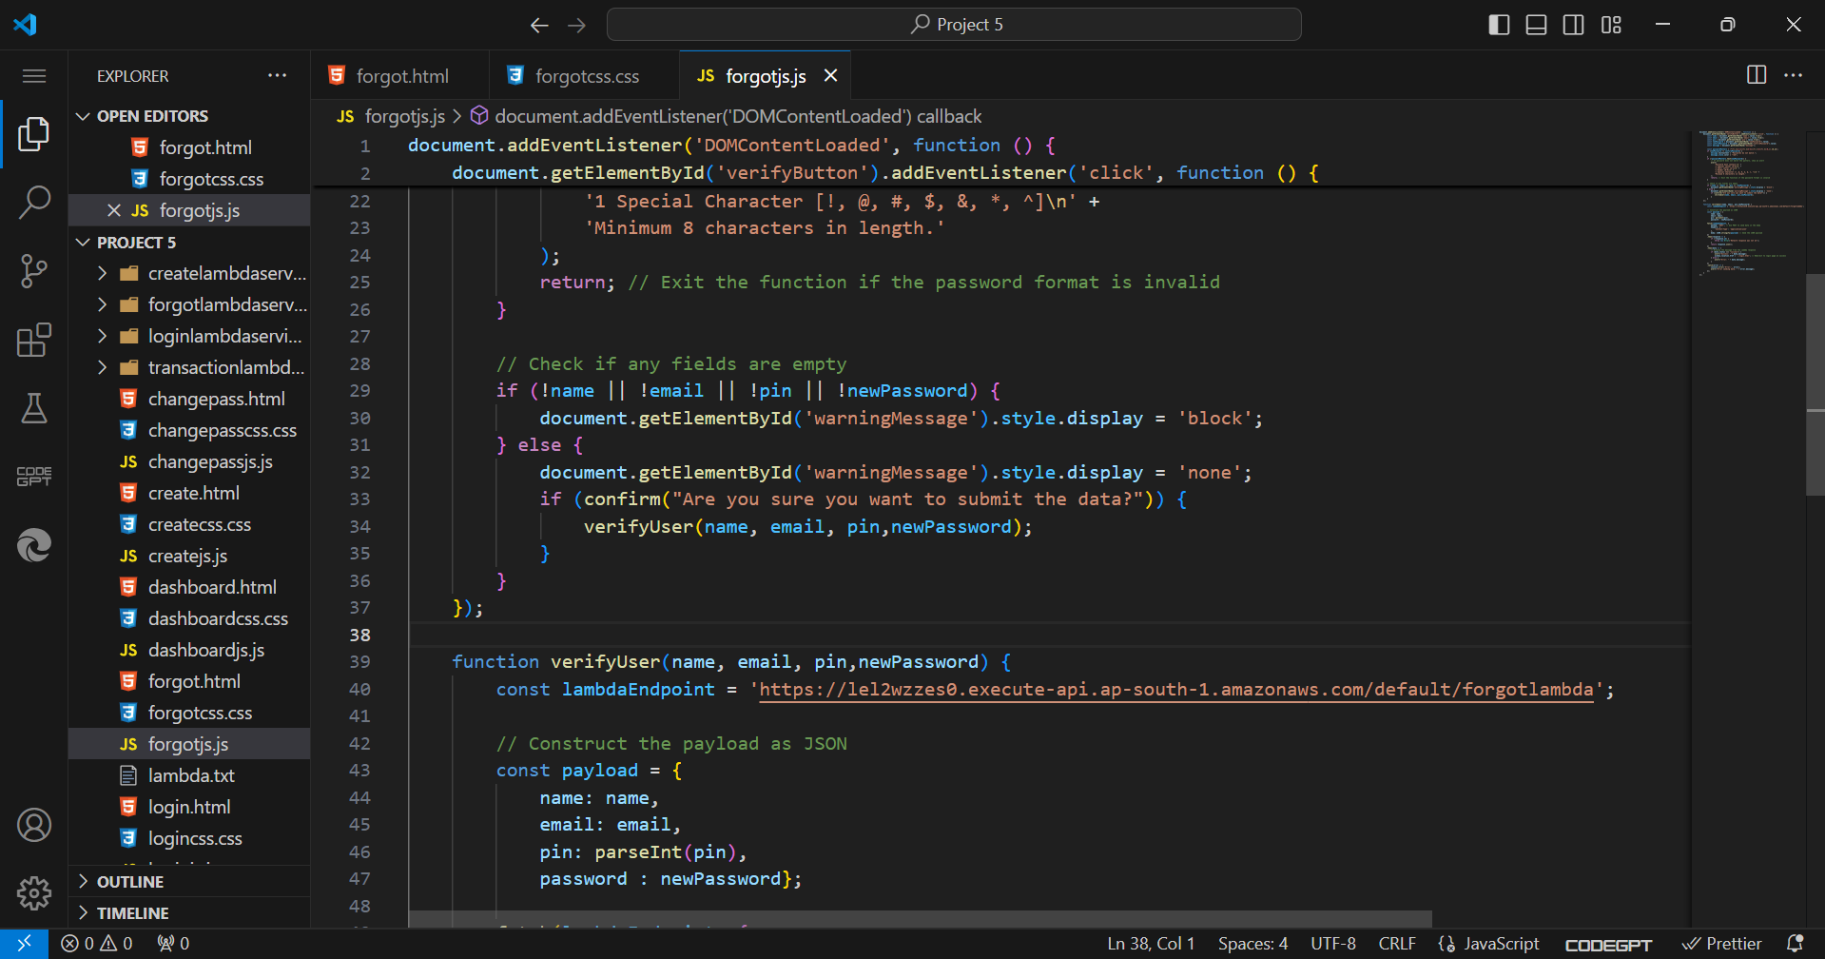
2.2.8 Paste the API Endpoint in JS Code of forgot page.

Slide 41
2.4 SettingUp Transactionlambda
Use of Transaction Lambda:
1.It is used to take the data of Dashboard of bank page from website to AWS Lambda.
2.If any data is missed it returns missing data field.
3.After login we have 3 options Deposit, Withdraw, Check Balance.
4.If Deposit is entered and clicked on submit button and it check the email , password in database if matched it adds the deposit amount to existing balance and return the statement to website.
5.If Withdraw is entered and clicked on submit and check the email , password in database, if matched it checks the Withdraw amount is less than balance in the account if there then it subtracts the withdraw amount from existing balance and return the statement to website.
6.If Check Balance is entered and clicked on submit button and check the email , password in the database if matched it takes yes or no and returns the balance to website
7.When Submit is clicked the data is taken to AWS Lambda & then lambda connects to RDS and returns the output to website.
8.Exit button directs you to login page.

Slide 42
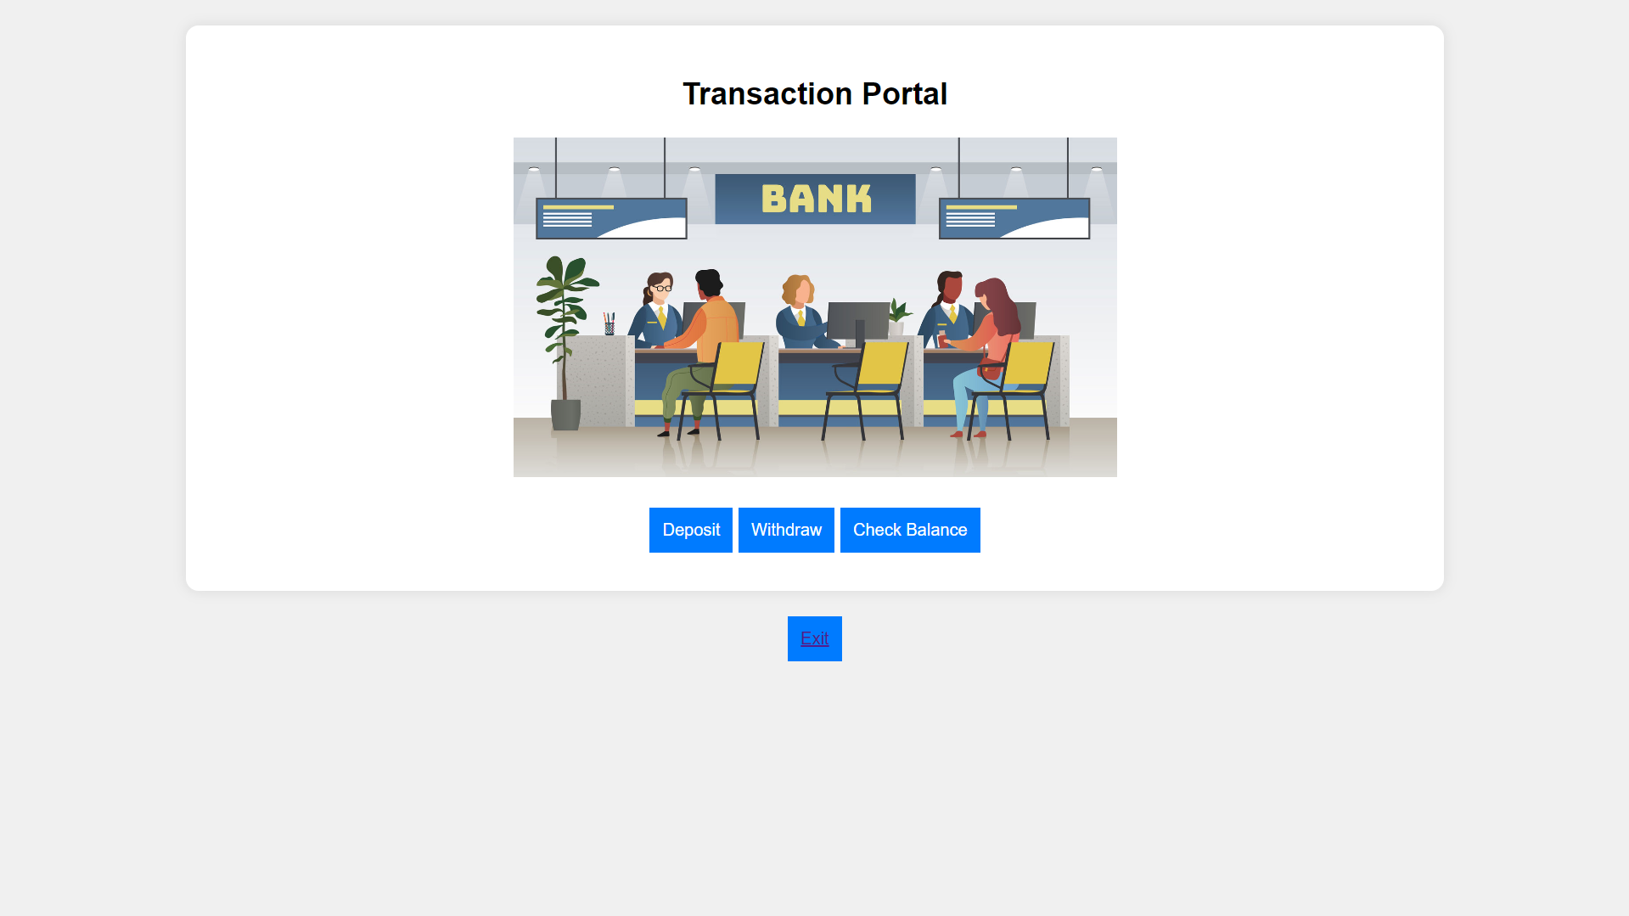
Dashboard of Bank Page

Slide 43
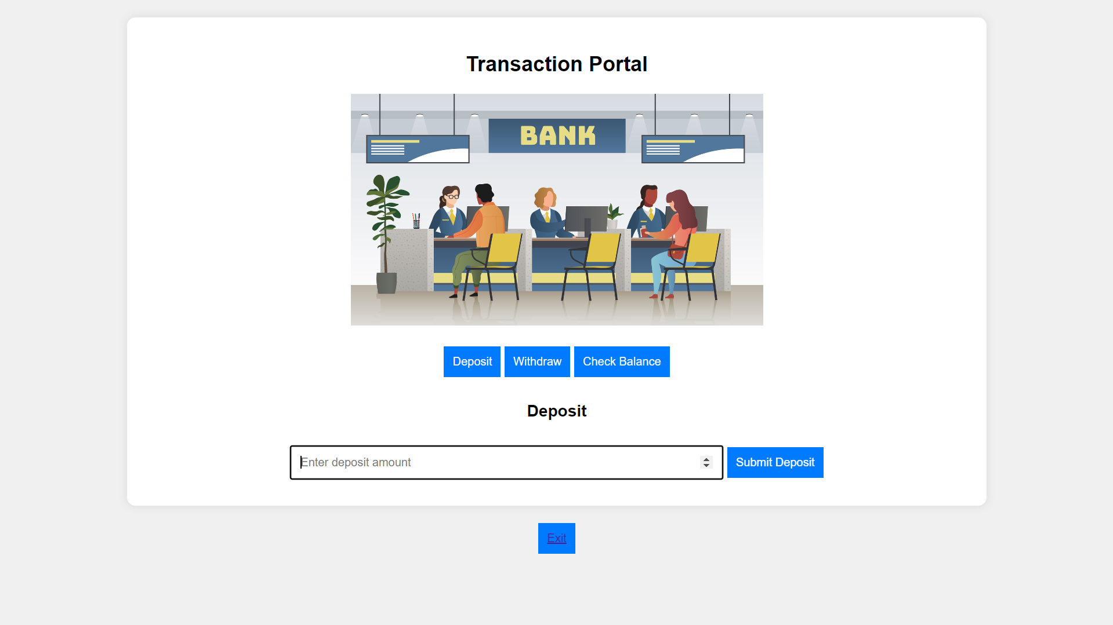
Click on Deposit

Slide 44
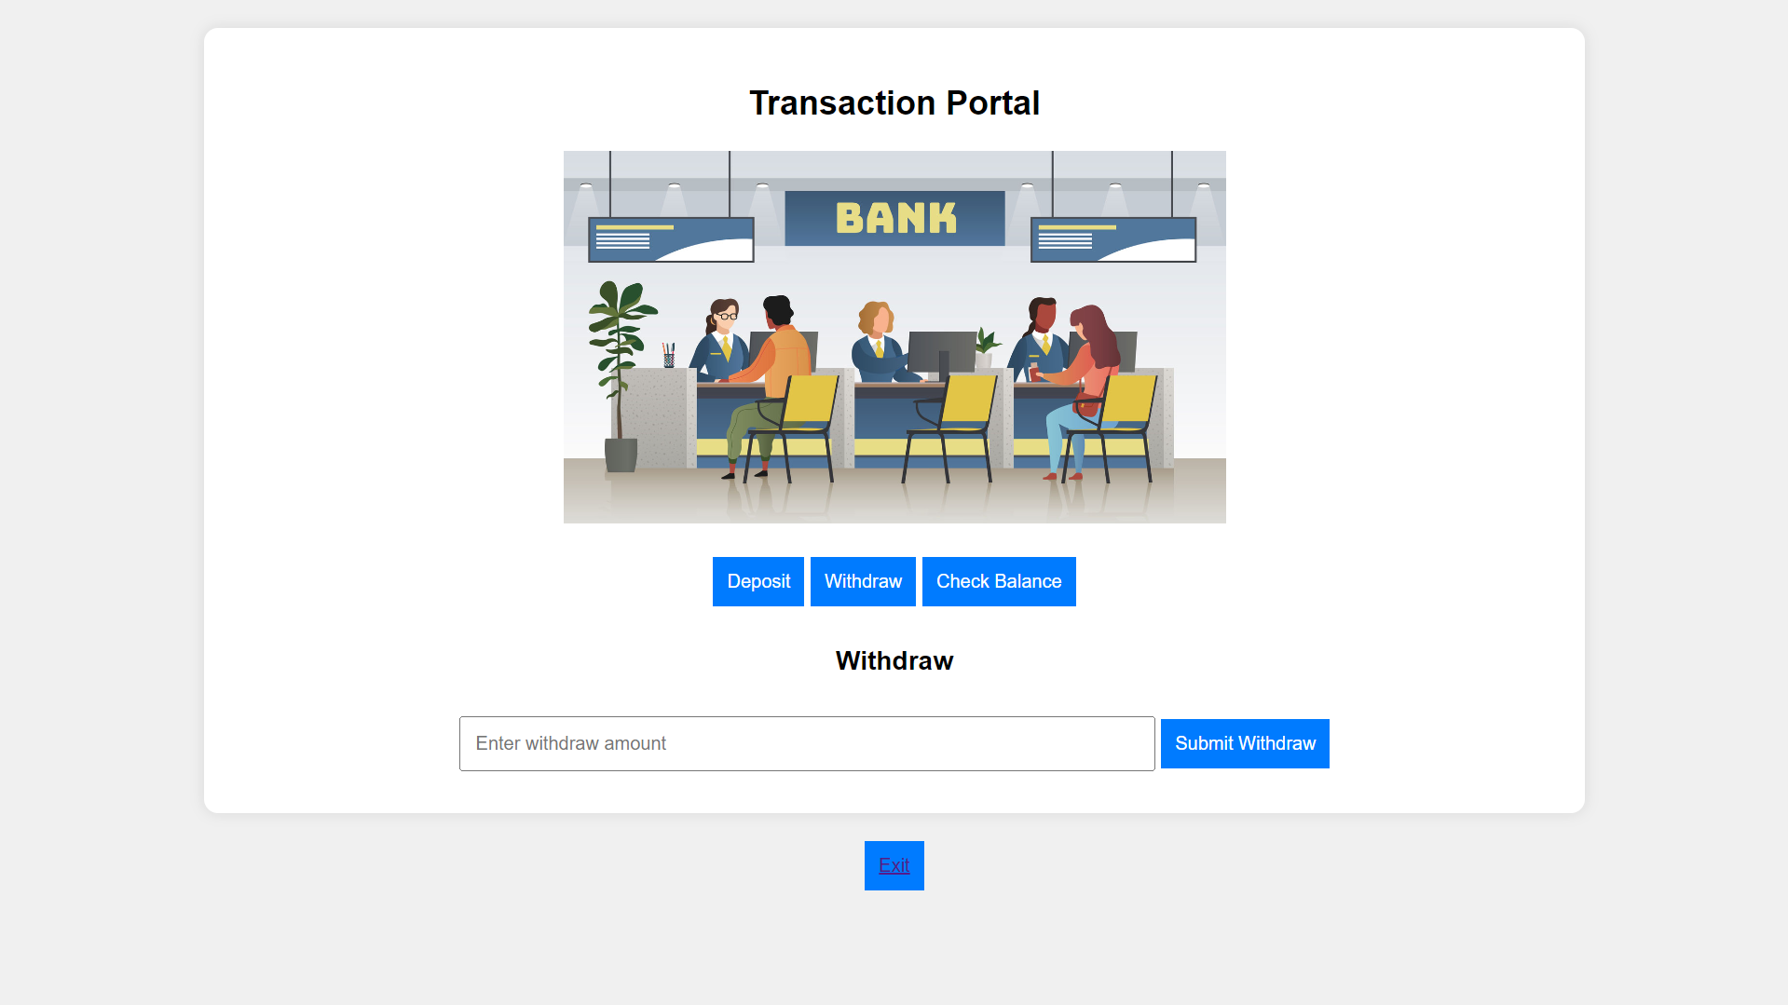
Click on Withdraw

Slide 45

Click on Check Balance

Slide 46

2.4.1 Create lambda function for Dashboard of Bank page.

Slide 47
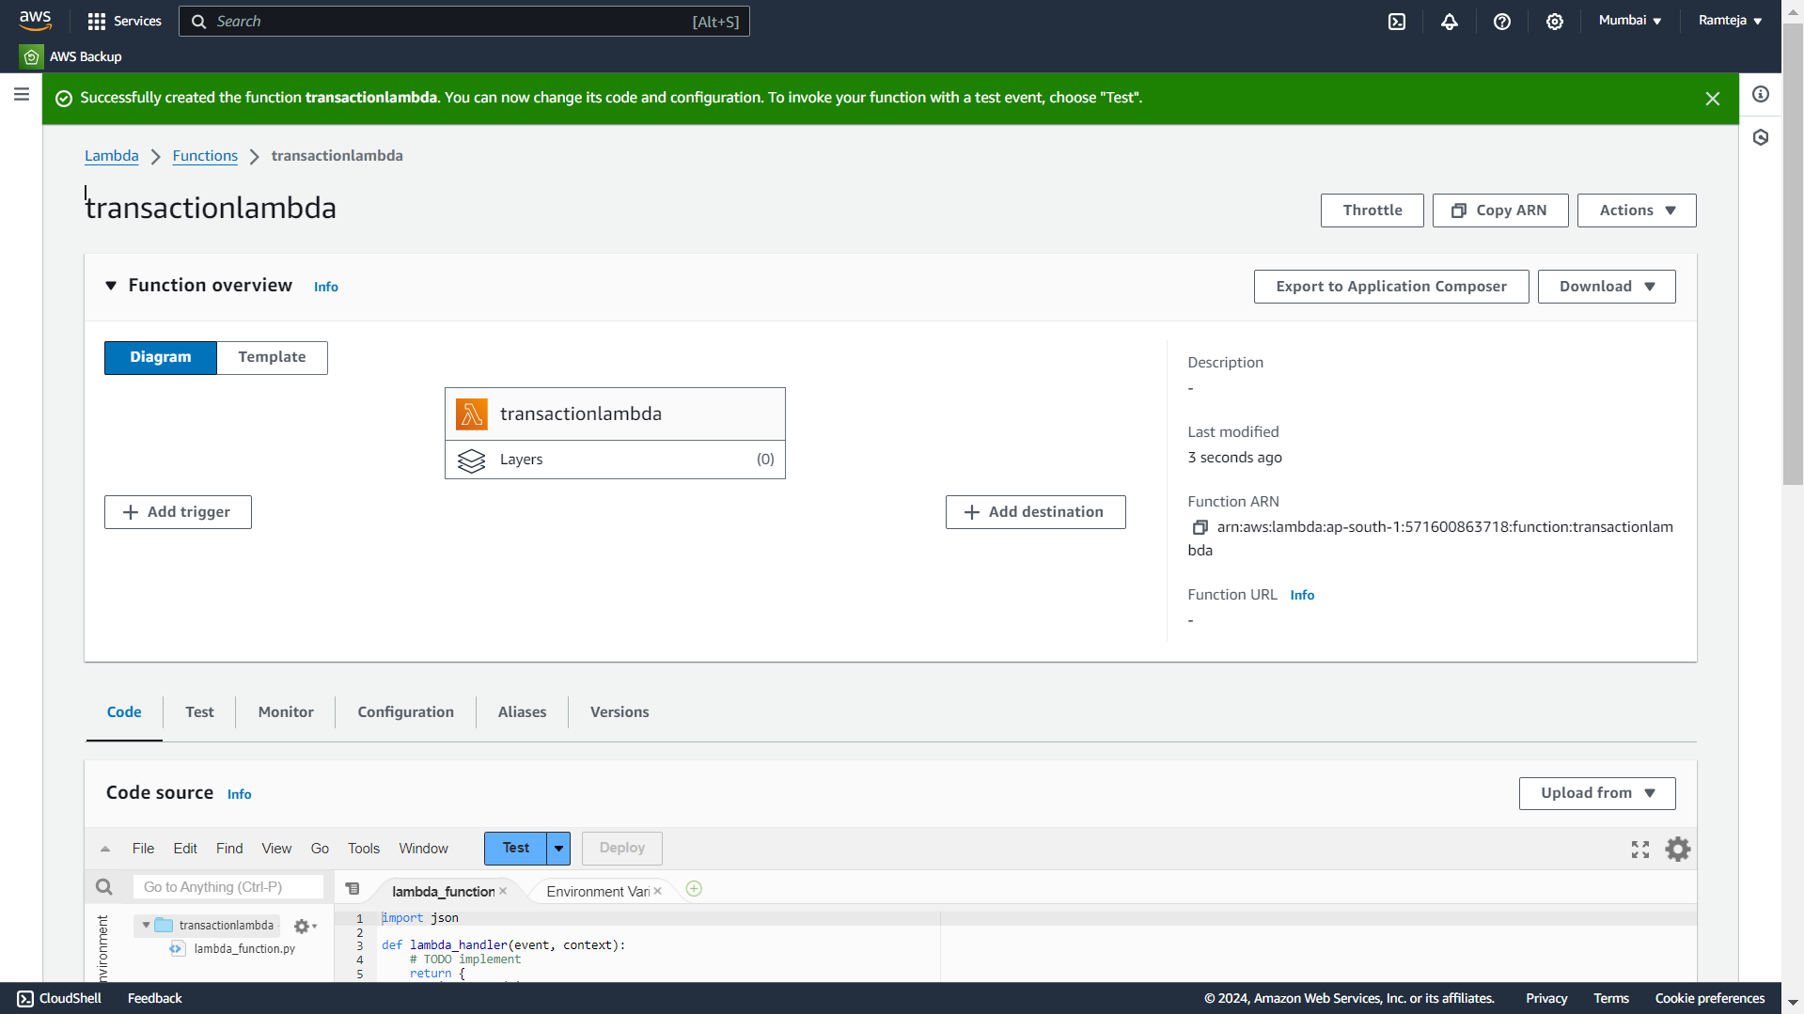
2.4.2 Lambda function “transactionlambda” is Created, Click on Add trigger.

Slide 48
2.4.3 Click on API Gateway.

Slide 49
2.4.4 Follow the steps in Setting UpLambda.

Slide 50
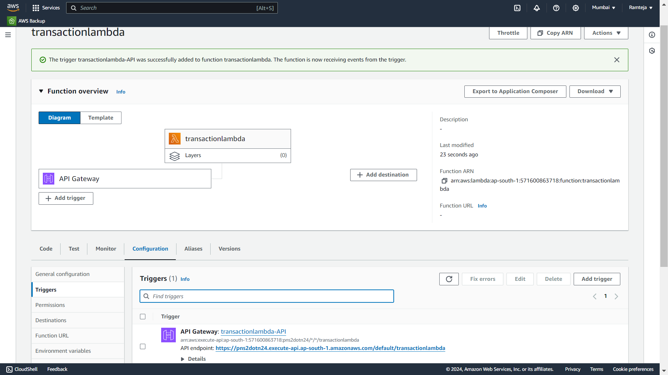
2.4.5 Open Configuration in Lambda Function to Copy API Gateway Url.

Slide 51
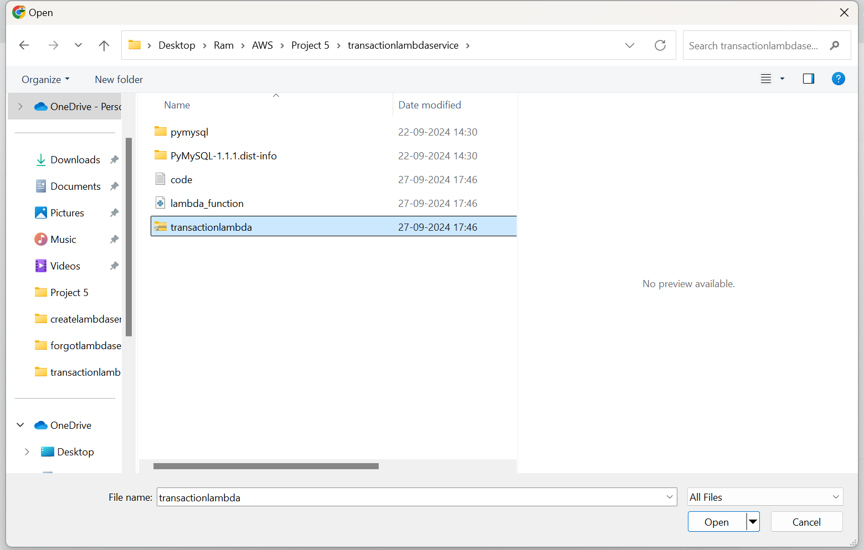
2.4.6 Choose Zip file.

Slide 52
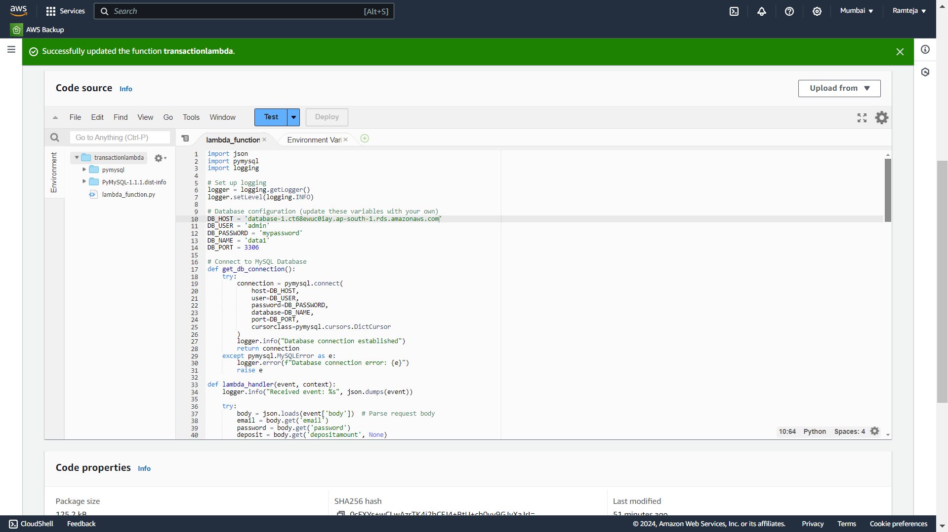
2.4.7 Code Uploaded Successfully.

Slide 53
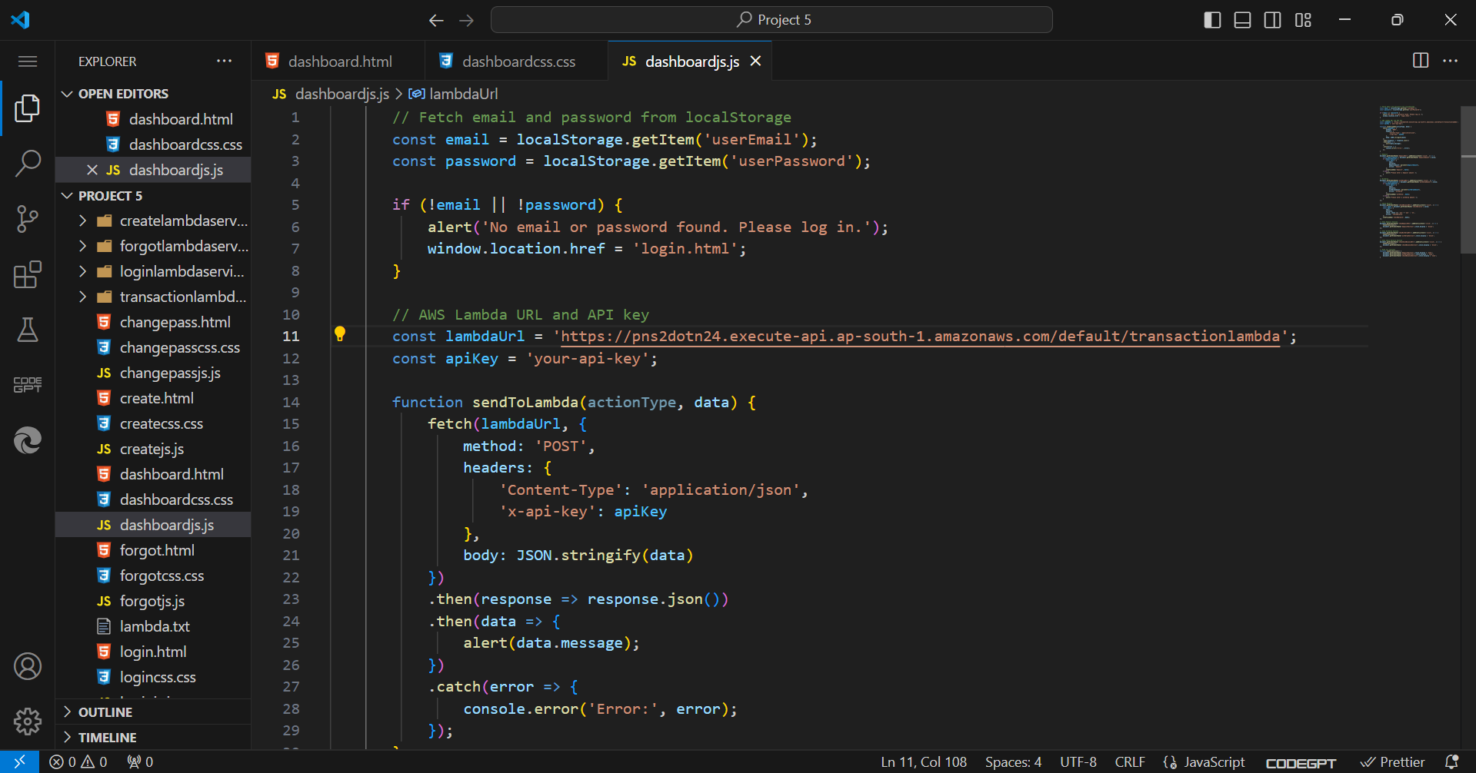
2.4.8 Paste the API Endpoint in JS Code of dashboard of bank page.

Slide 54
4.SettingUp S3 for Hosting
1.Search for S3 in Search bar and open S3 dashboard, Click on Create Bucket.
2.Select the bucket type as General Purpose, Give Unique bucket name to your bucket.
3.Checkmark on Block All public Access, Select ACL’s disable in Object Ownership & Create on Bucket.
4. Select the S3 Bucket ,Click on Objects ,Click on Upload & Choose the files from your PC.
5.Click on file to be uploaded (Html CSS JS) and Click on Upload.
6.When we use the Object URL of this file in S3 bucket it will be only available for your Private users.
7.If the Public Users wants to access the website.
8.Select the file in S3 bucket ,Click on permissions, Uncheck mark the “Block all public access” to convert into Public ,Copy the Bucket ARN number & Click on Edit on Bucket Policy.

Slide 55
9.Select S3 bucket policy in Select Policy type ,Click on Allow Effects & Type * in Principles.
10.Check mark All Actions , Paste the Bucket ARN and enter /* after Bucket ARN.
11.Click On Add Statement & Click on Generate Policy.
12.Copy the code from AWS Policy and Paste it in Bucket Policy & Save it.
13.Bucket Policy edited Successfully.
14. Now public users can access our website by Object URL.

Slide 56
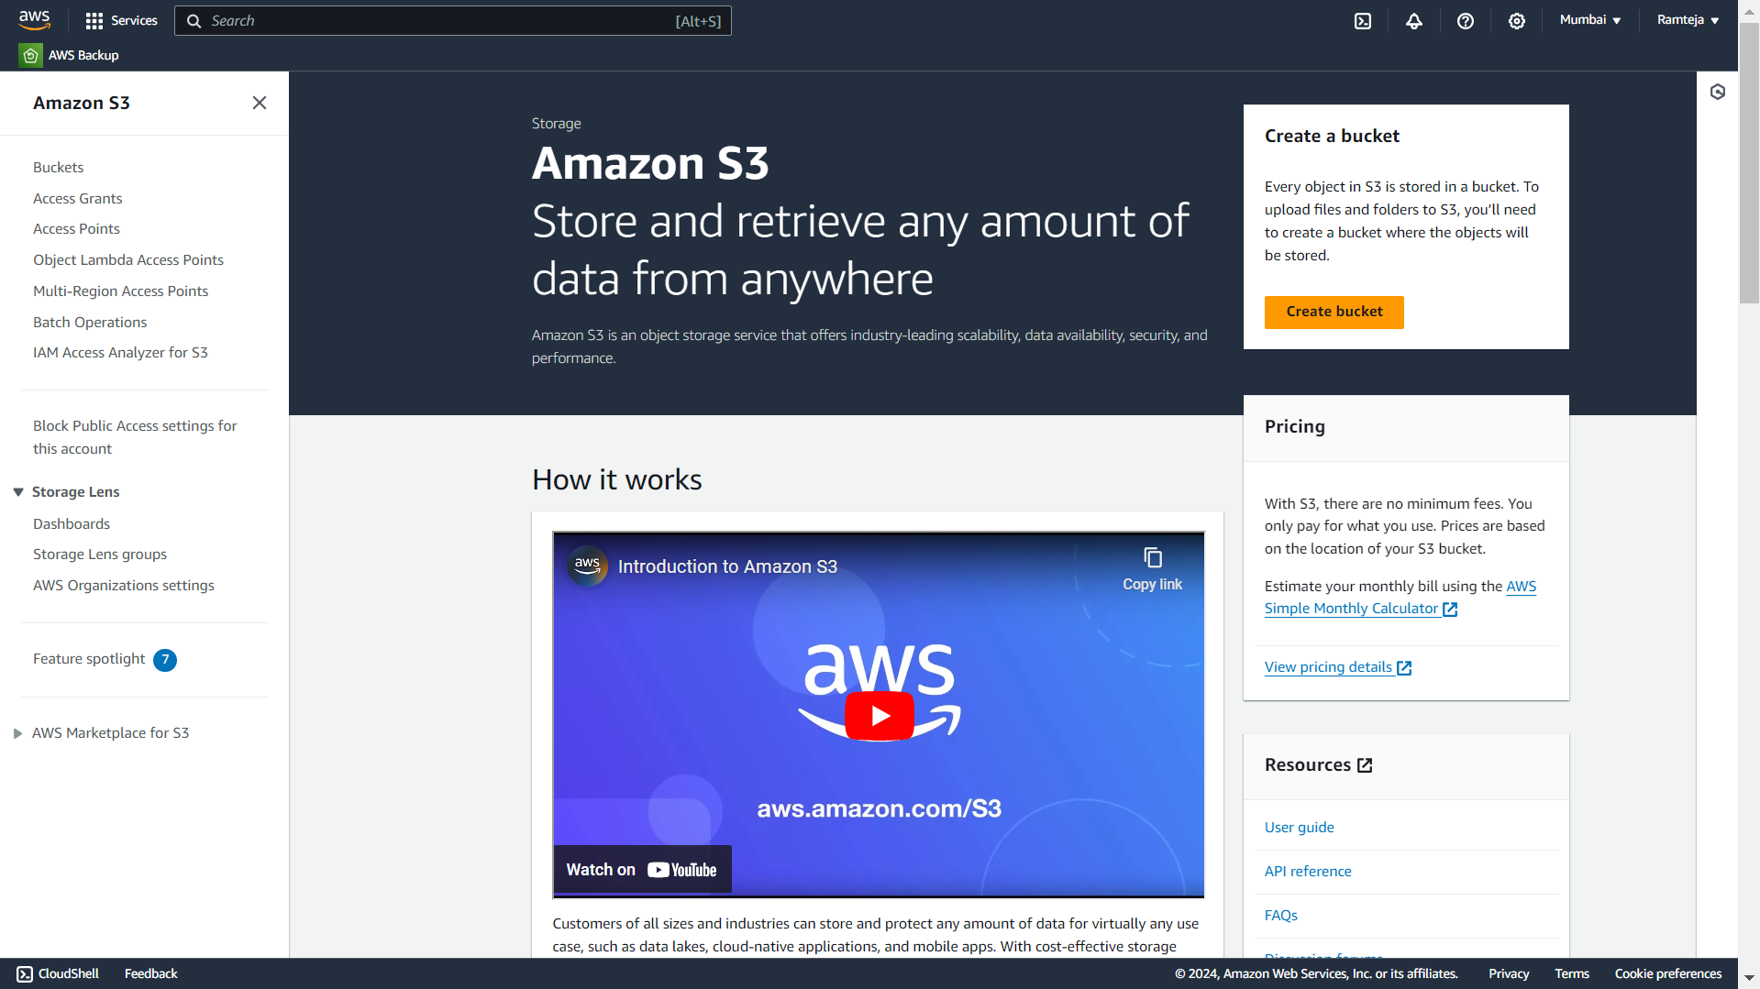
4.1 Click On Create Bucket.

Slide 57
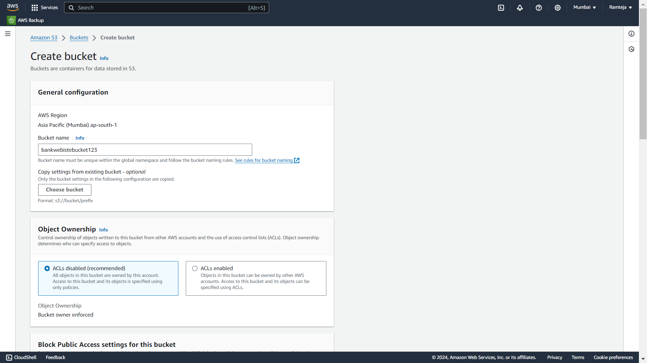
4.2 Give Unique Name for your Bucket.

Slide 58
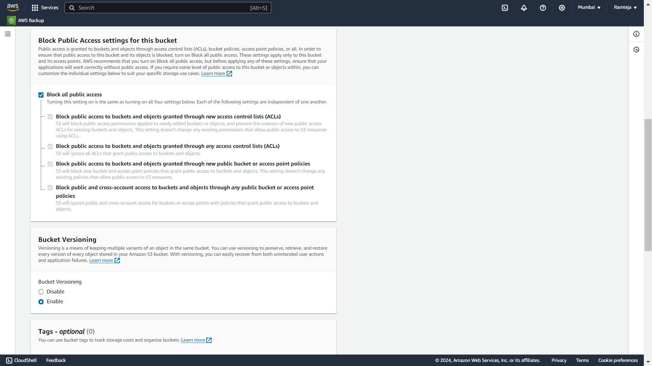
4.3 Make Sure that the Checkmark is ticked in Block all public access.

Slide 59
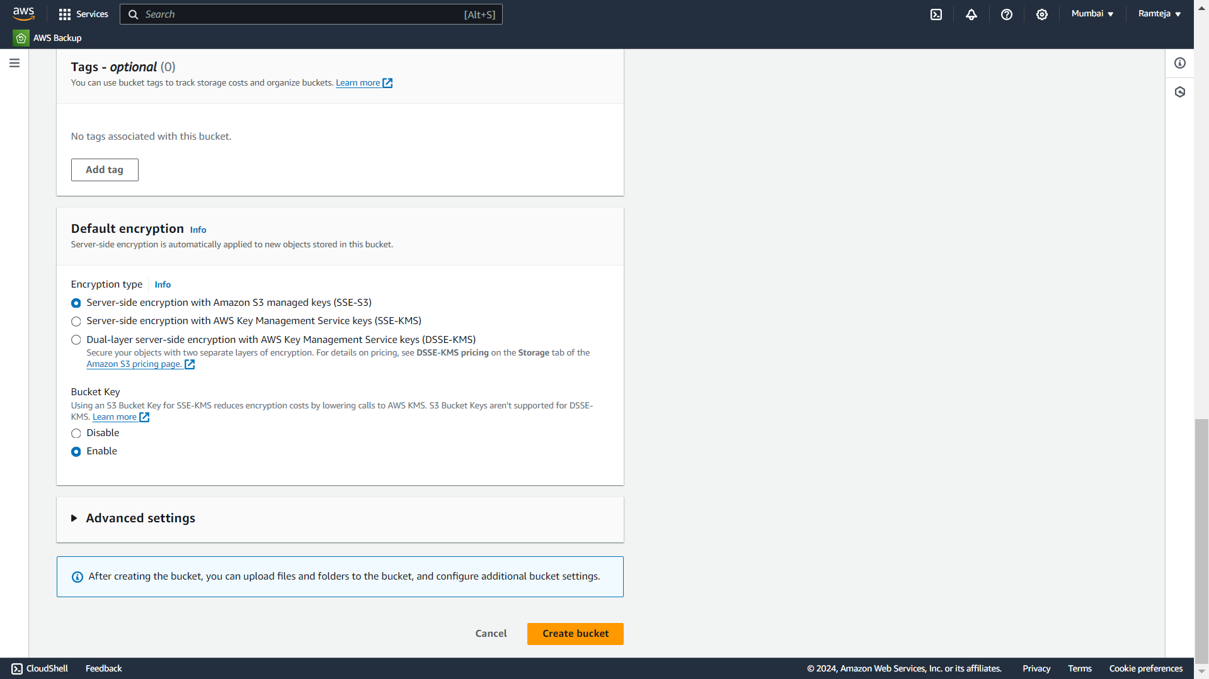
4.4 Click on Create bucket.

Slide 60
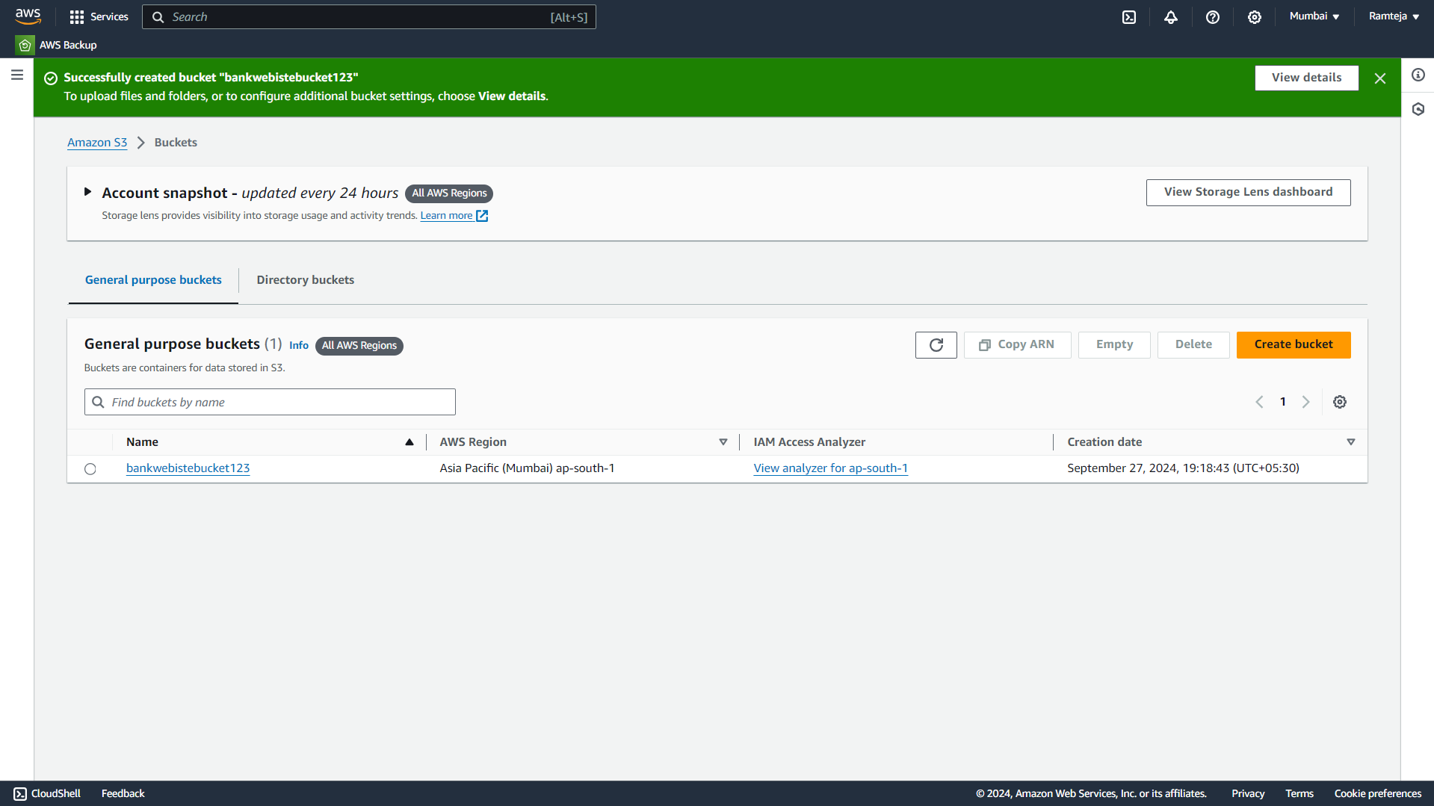
4.5 Bucket Created Successfully & Open the bucket.

Slide 61
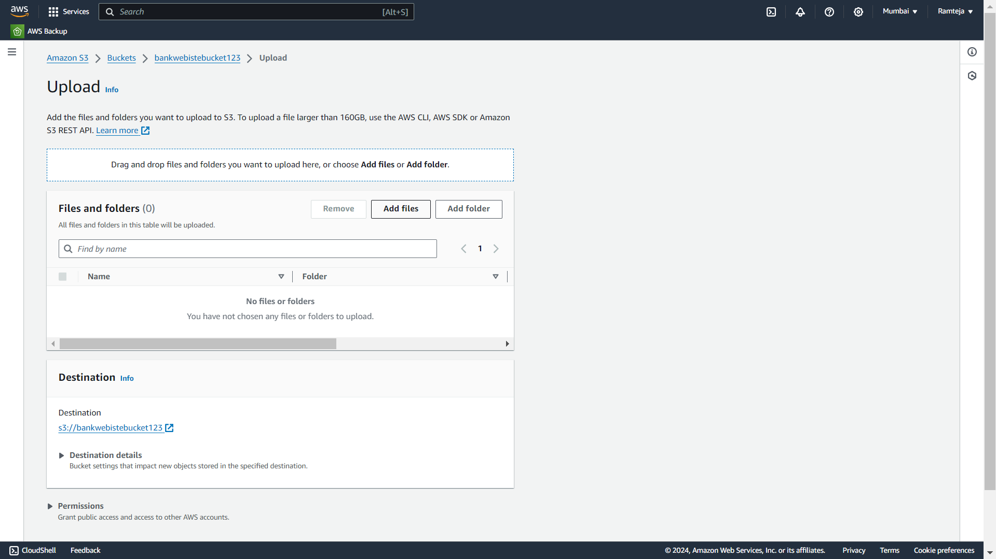
4.6 Click on Upload to add files in bucket.

Slide 62
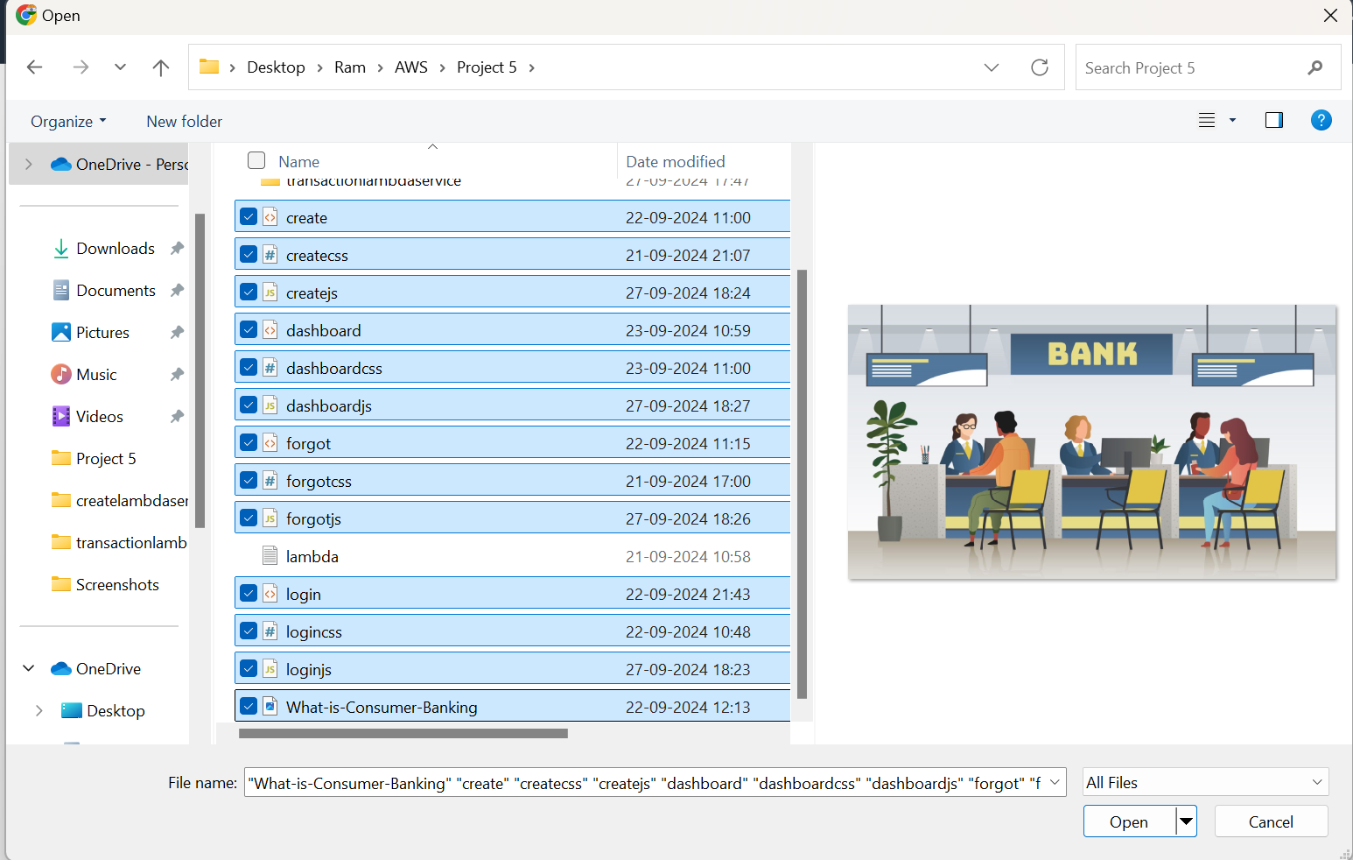
4.7 Select the files from the PC.

Slide 63
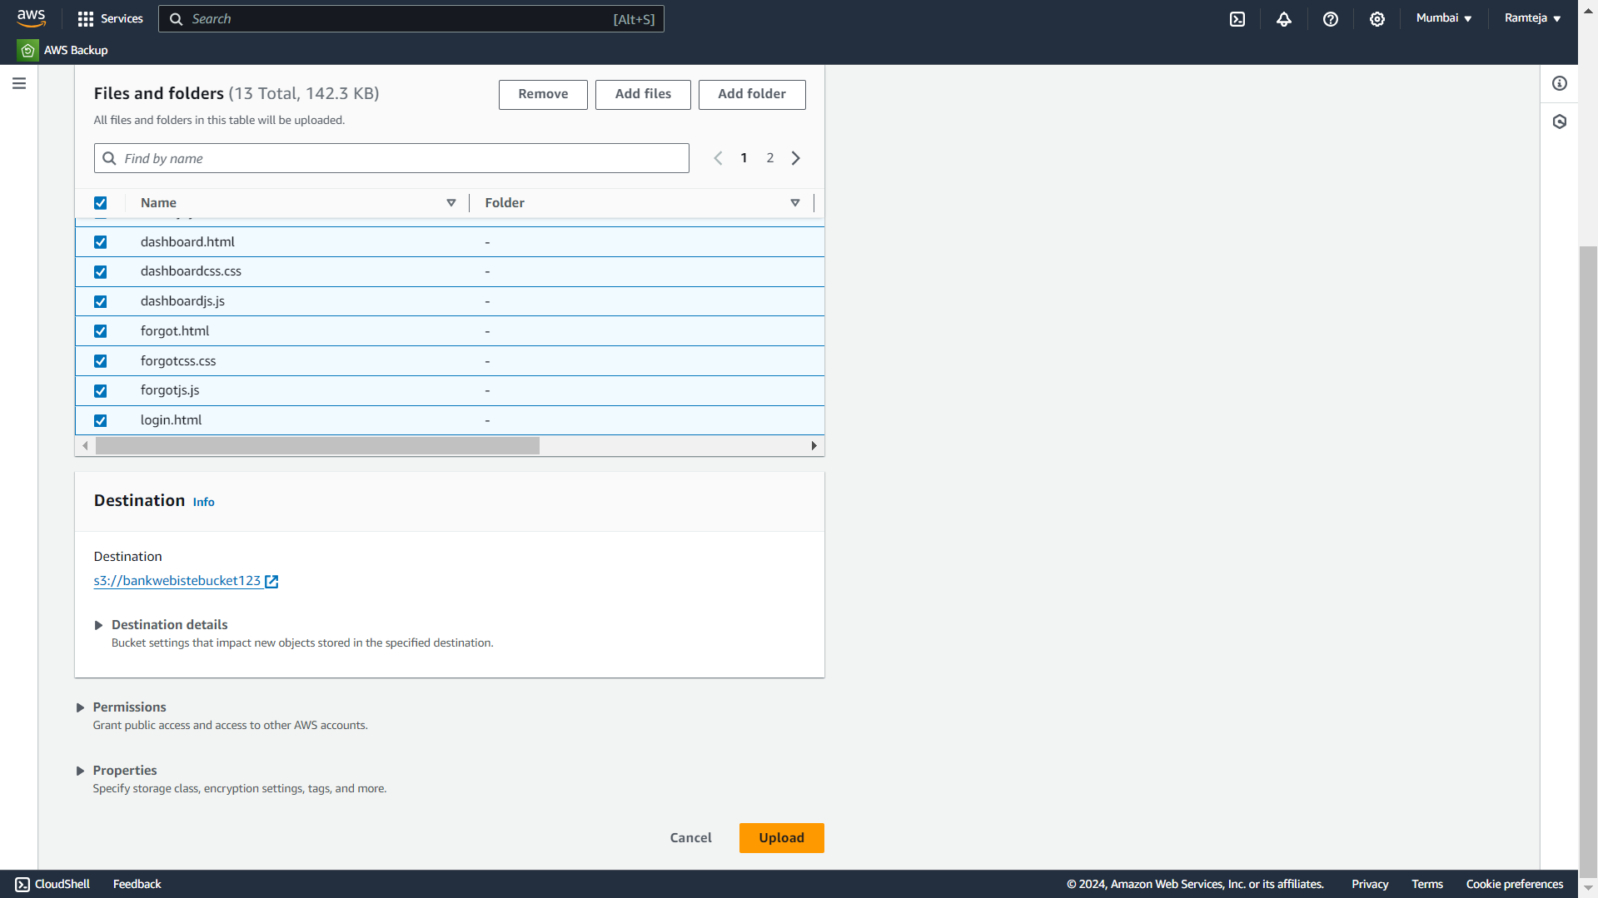
4.8 Select all Files & Click Upload.

Slide 64
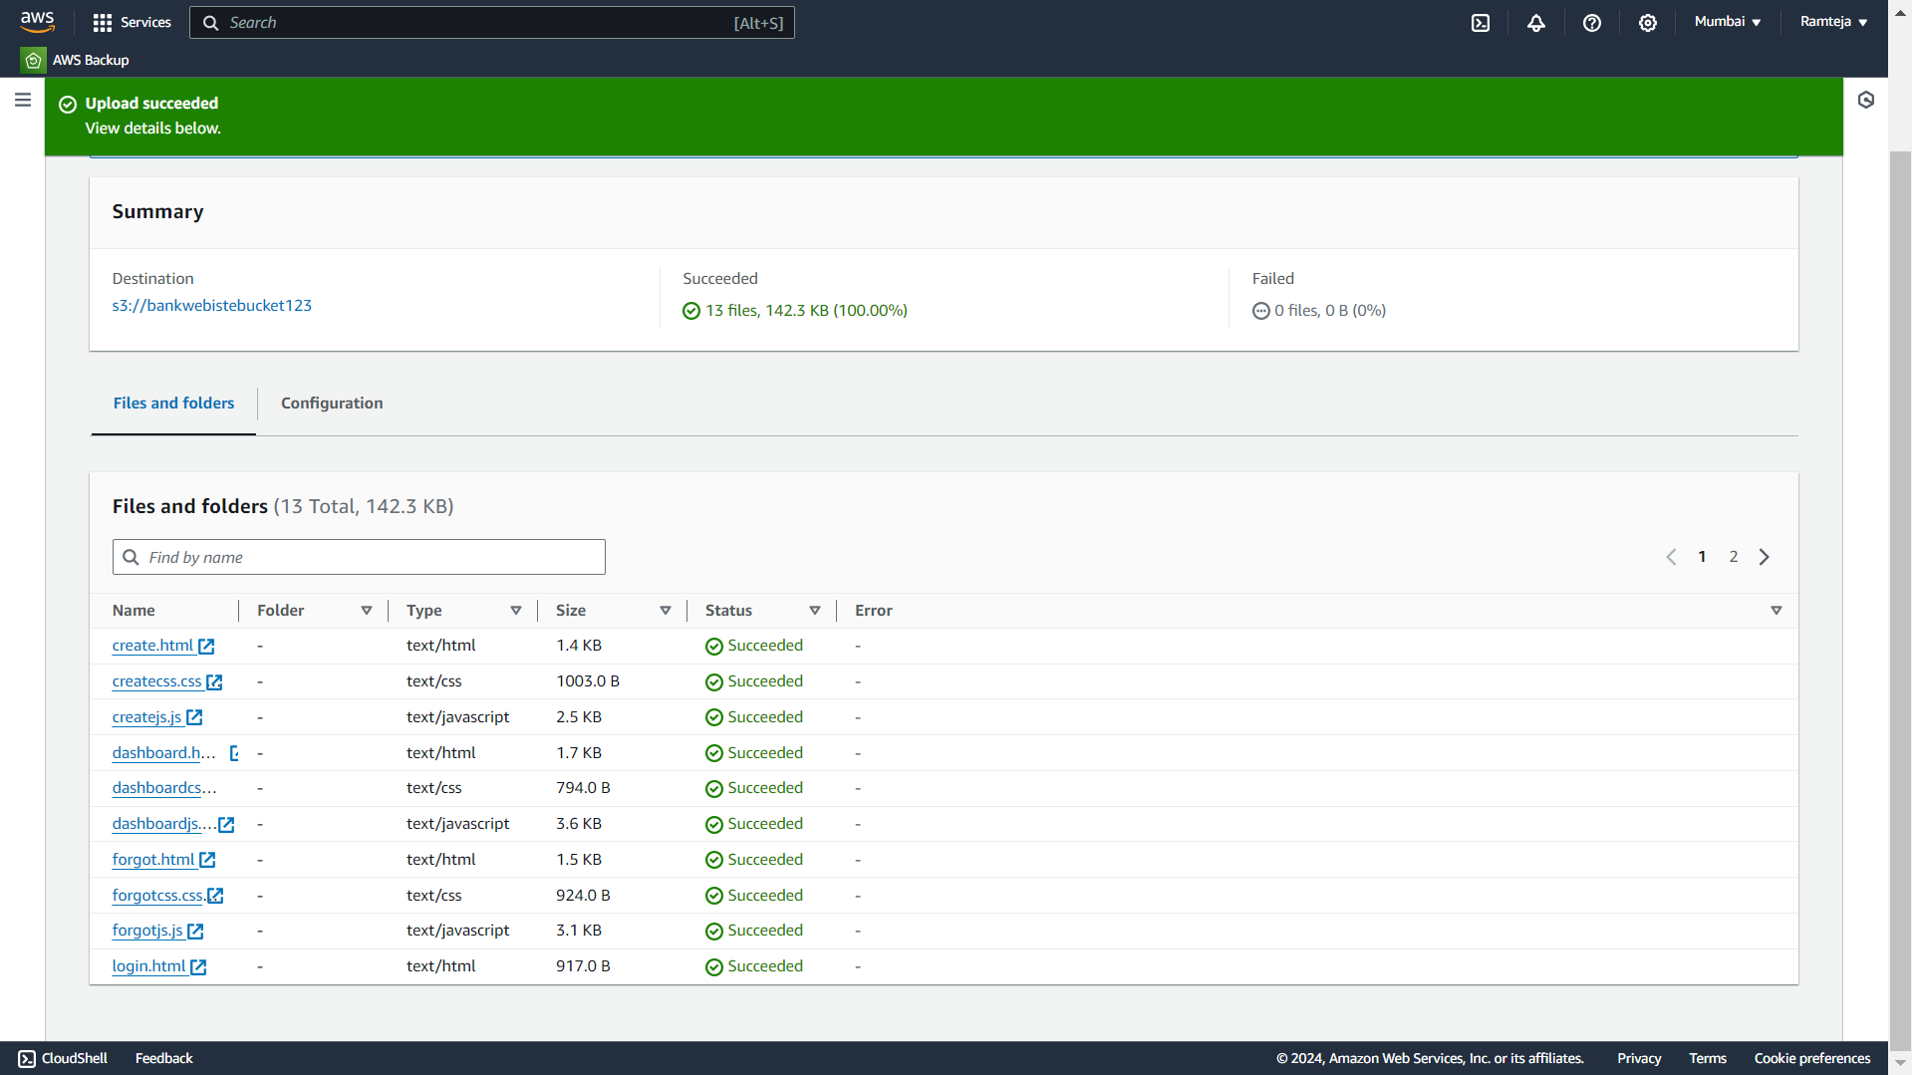
4.9 Objects in S3 bucket added Successfully.

Slide 65
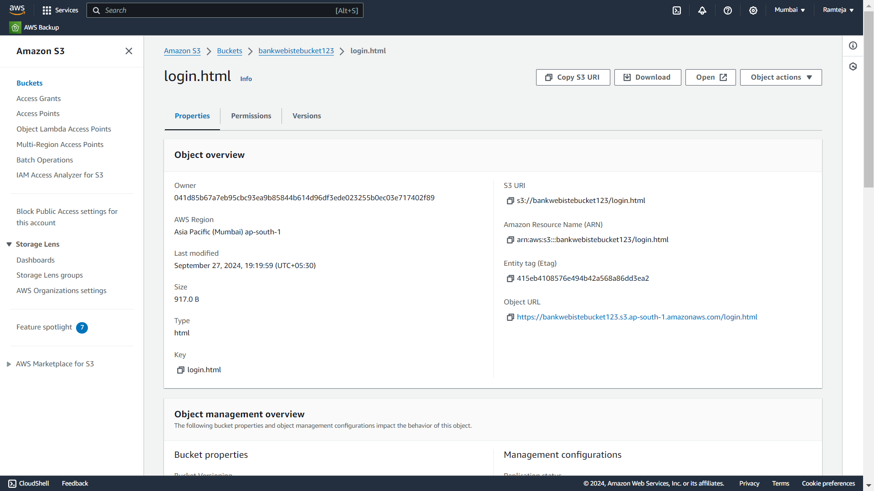
4.10 Copy the Object-URL of login.html

Slide 66
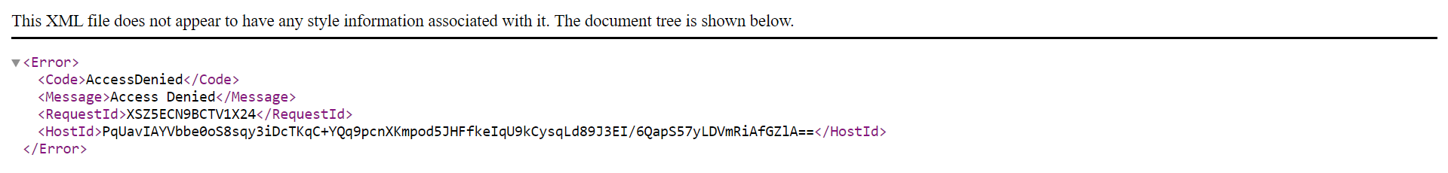
4.11 The bucket is private so link will not work.

Slide 67
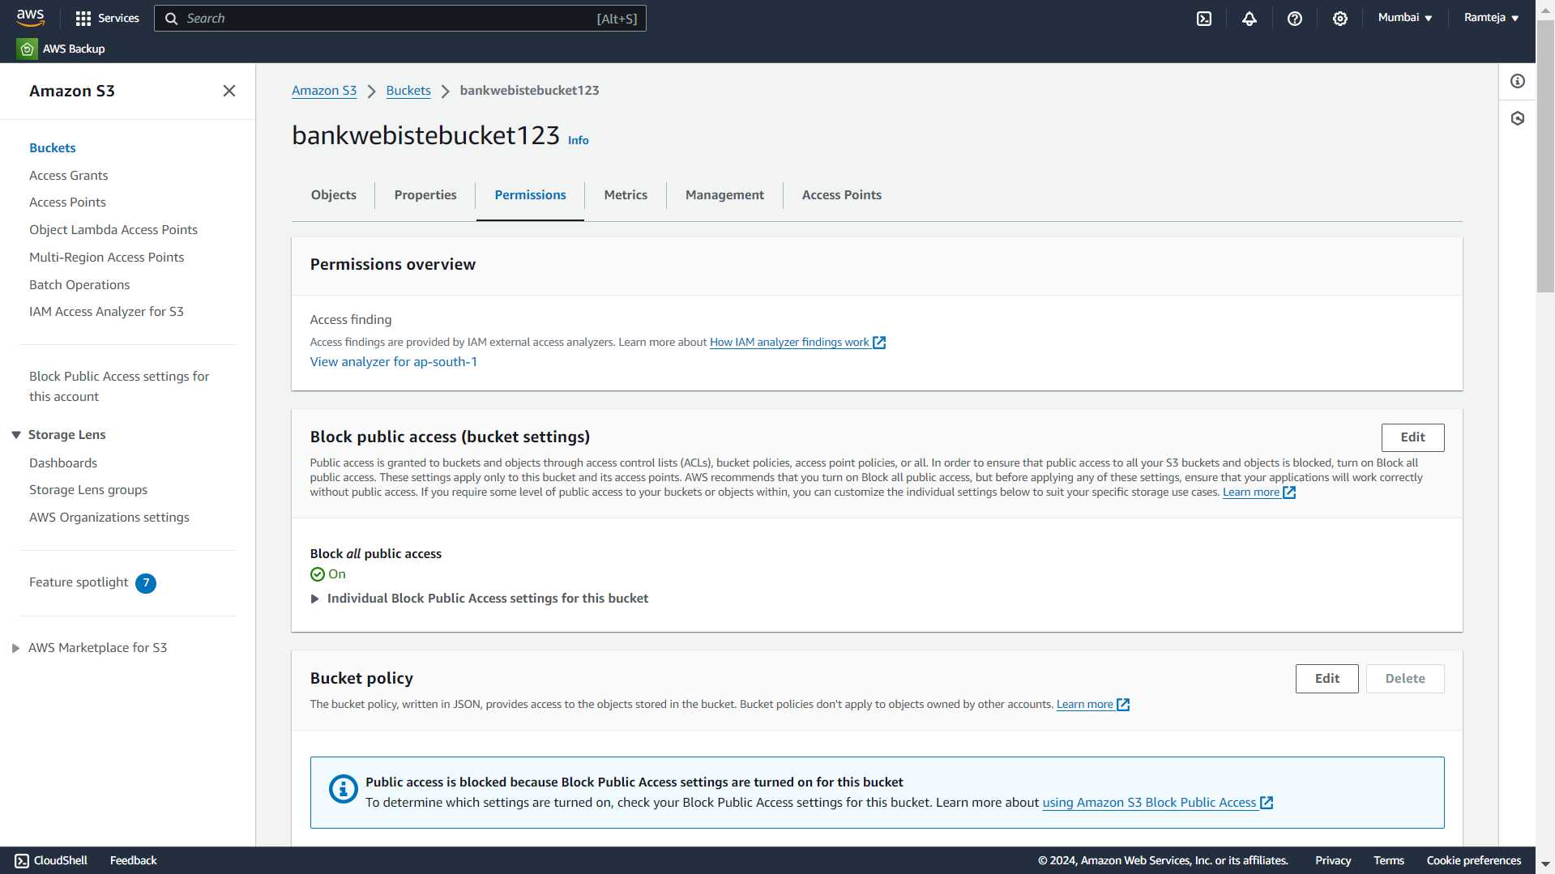
4.12 Click on Edit in Block Public Access.

Slide 68
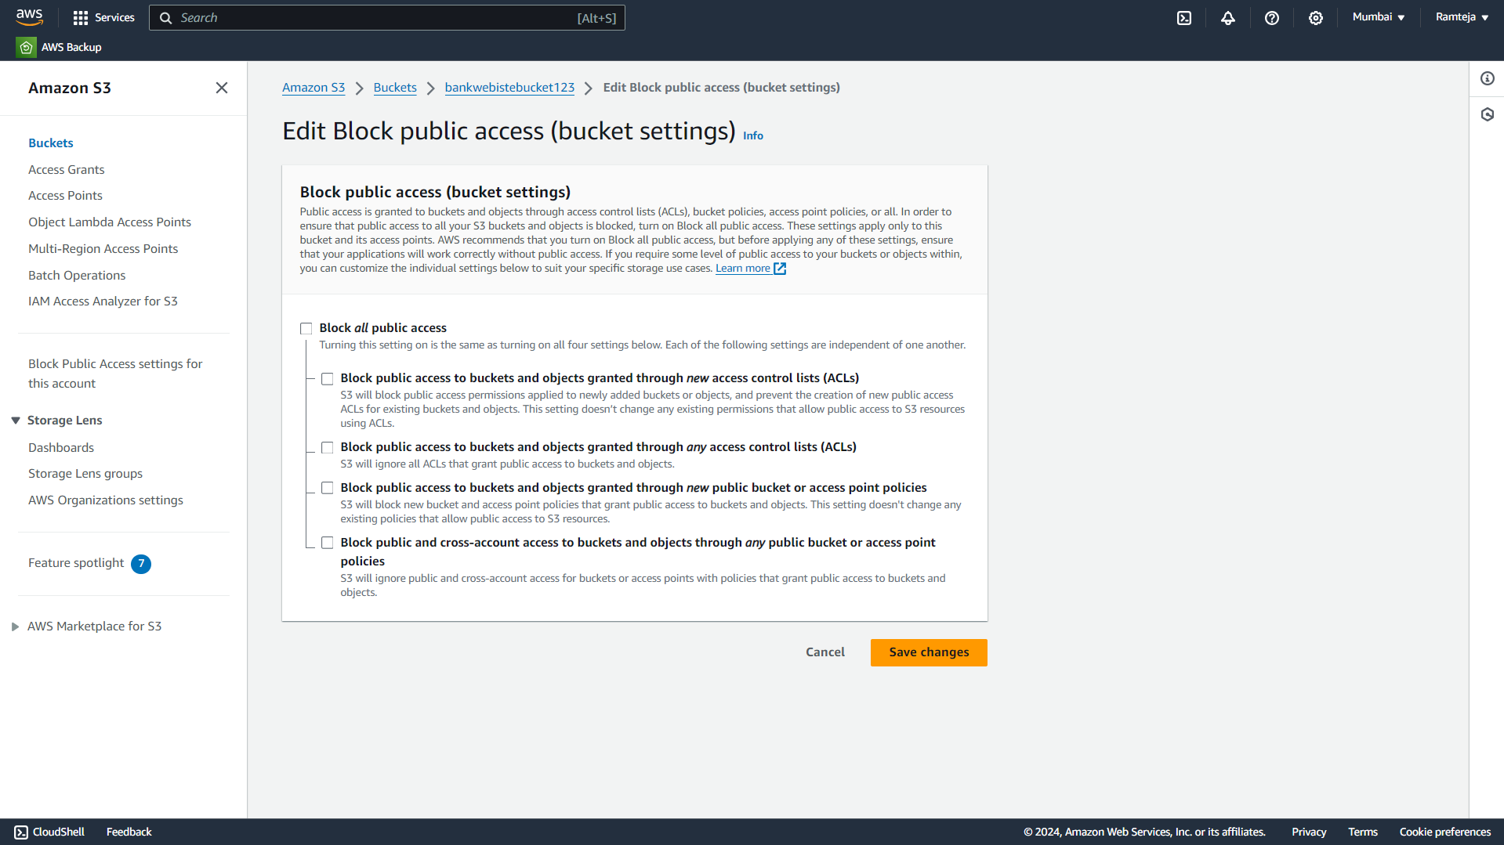
4.13 Uncheck the Block all public access.

Slide 69
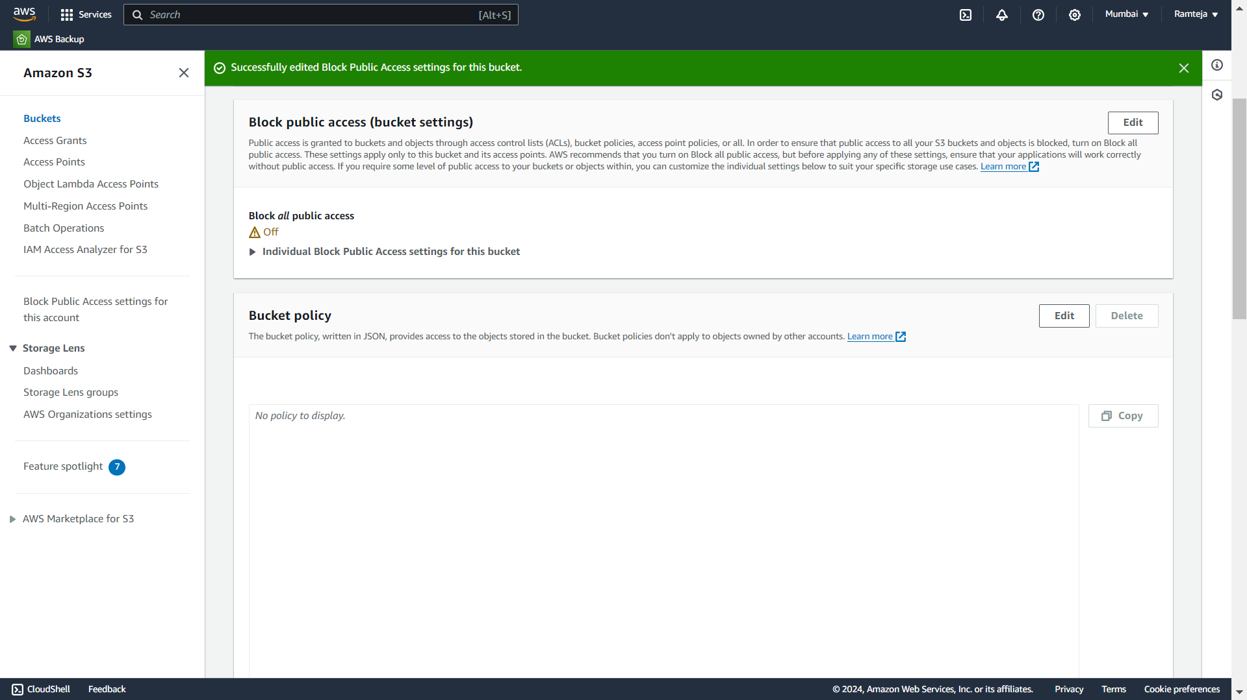
4.14 Click on Edit in Bucket Policy.

Slide 70
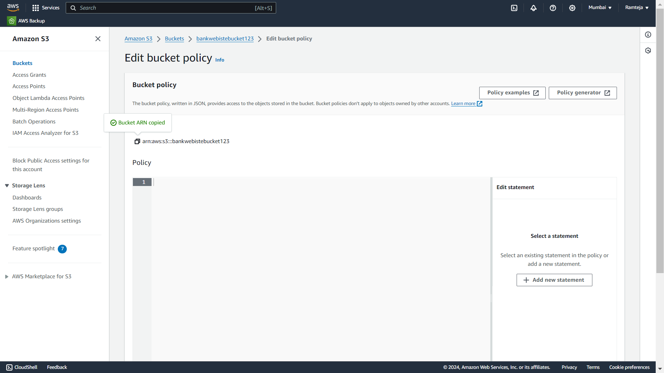
4.15 Copy the Bucket ARN & Click on Policy Generator.

Slide 71
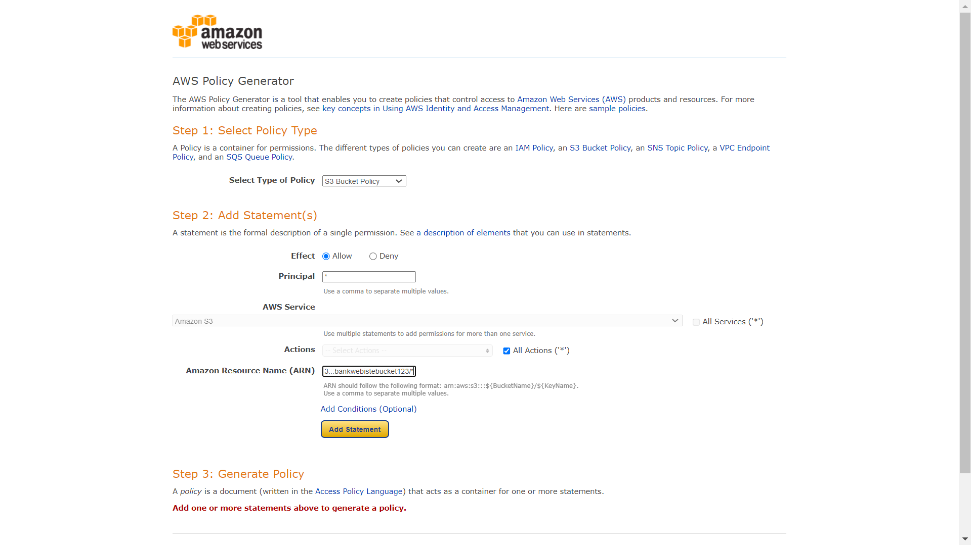
4.16 Create a New Policy Generator.

Slide 72
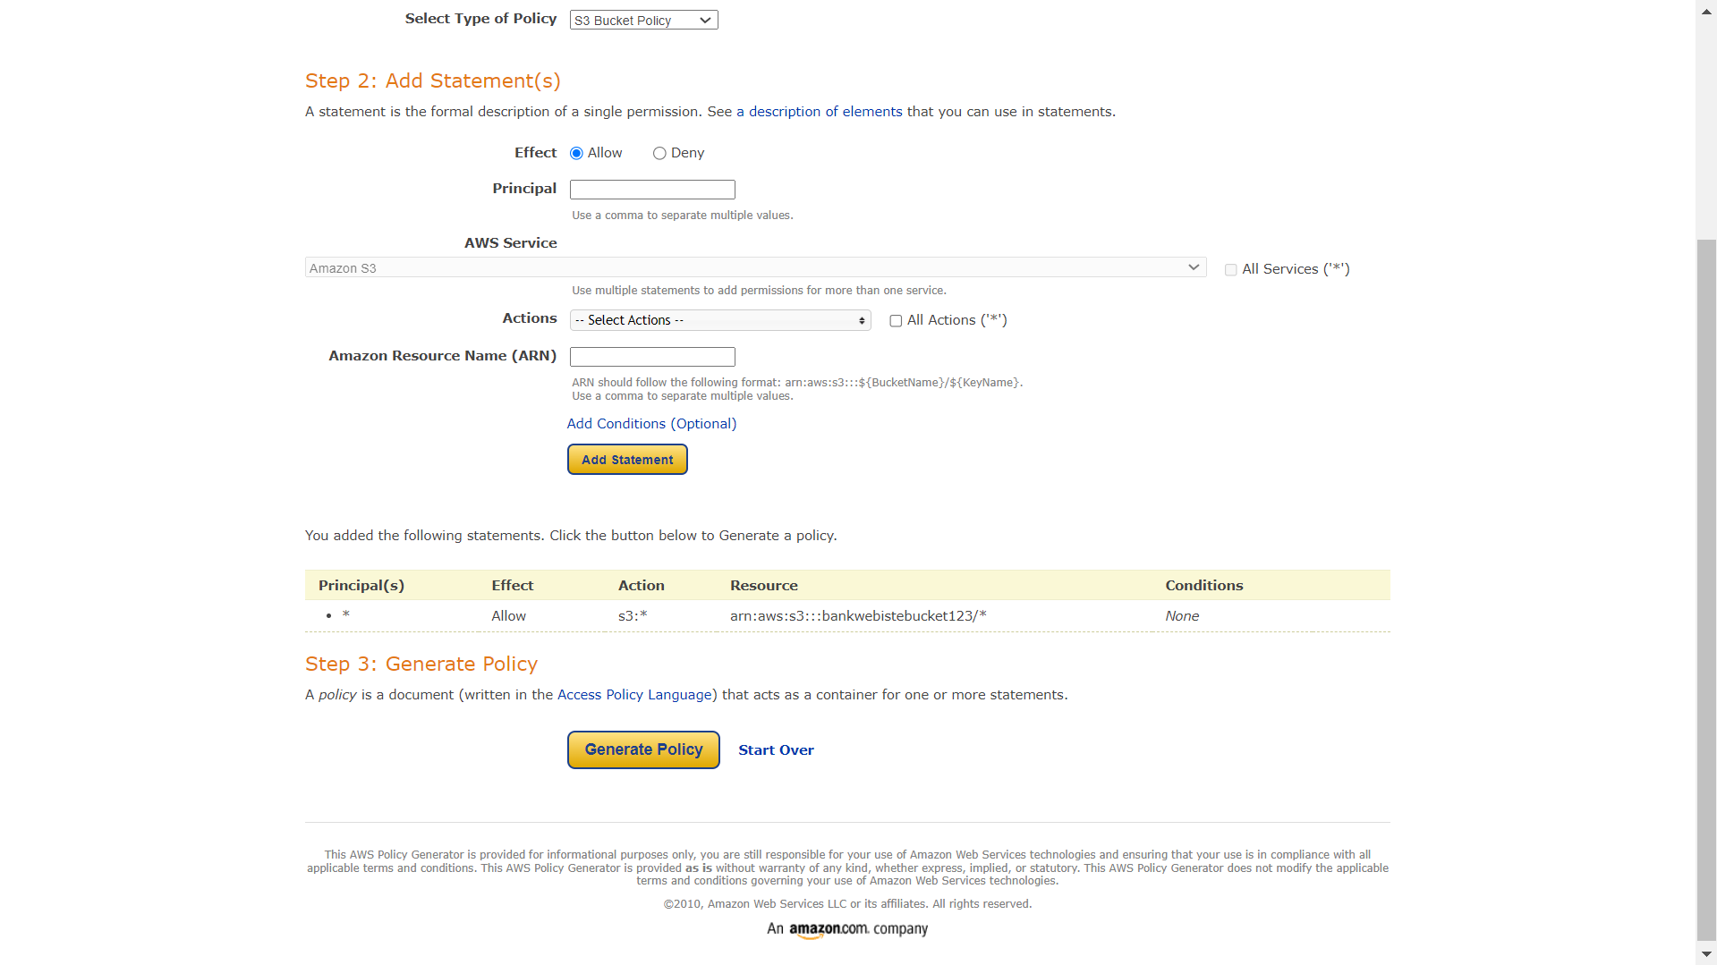
4.17 Follow the steps in SettingUp S3.

Slide 73
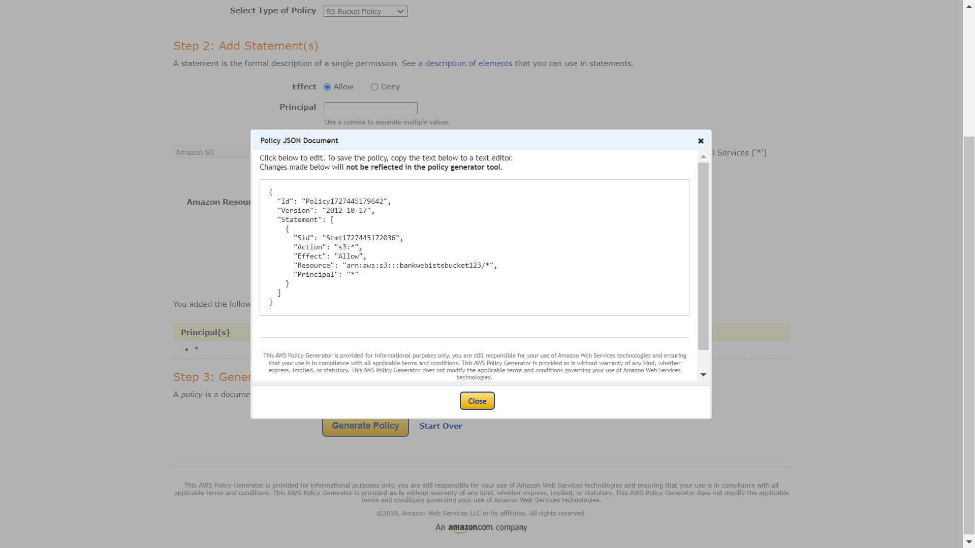
4.18 Click on Generate Policy & Copy the code.

Slide 74

4.19 Paste the Code here & Click on Save.

Slide 75

4.20 Copy the Object URL of login.html to share everyone.

Slide 76
5.Setting Up RDS
1.Search for RDS in Search bar and open RDS dashboard, Click on Dashboard.
2.Click on Create Dashboard ,Select Standard Create in Choose Database Creation Method & Select Engine of database.
3.Select Free Tier in Templates , Give Name to database, Create Username & Create Master Password for database in Credential Settings.
4.Select the Instance type, Storage & Select default VPC ,Checkmark Yes in Public Access.
5.Select default Security Group & Choose Availability Zone.
6.Enable Enhance Monitoring In Monitoring & Click on Create.
7.Database is created , Open database , Click on Connectivity & Security.
8.Click on VPC Security groups, Click on default group ,it will direct us to Security group details.
9.Click on Inbound rules , Click on edit Inbound rules & Click add rules – Select Custom TCP with port number 3306(Database port number) & Click on save.
10.Copy the Endpoint of the Database. (Paste it in Lambda & Dbeaver).

Slide 77

5.1 Click on Dashboard in RDS Dashboard.

Slide 78

5.2 Click on Create Databases.

Slide 79

5.3 Select Standard Create & Engine of database.

Slide 80

5.4 Select Free Tier in Templates.

Slide 81

5.5 Give Name , Username & Create Password for database.

Slide 82

5.6 Select the Instance type & Storage.

Slide 83

5.7 Select default VPC & Public Access as Yes.

Slide 84

5.8 Select VPC Security Group.

Slide 85

5.9 Click on Checkmark of Enable Monitoring.

Slide 86

5.10 Click on Create database.

Slide 87

5.11 It will Take a while to create database.

Slide 88

5.12 RDS Created Successfully.

Slide 89

5.13 Open the database & Click on Security Groups.

Slide 90

5.14 Click on Security Group.

Slide 91

5.15 Click on Edit Inbound rules.

Slide 92

5.16 Add rule for Custom TCP-3306 and click on save.

Slide 93

5.17 Rule is added to Security Group.

Slide 94
6.DBeaver
1.Install DBeaver & Open.
2.Click on connect to database logo, Search for our Database Engine & Click Next.
3.Paste the Database Endpoint URL in Server Host, Enter the Username, Password & Click on Test Connection.
4.Click on ok & then Finish to Established Connection between RDS Database & Dbeaver.
5.Expand Database-1,Right Click on New Database & Enter Database name Click on ok.
6.Expand data1,Right click on it ,Select SQL editor & Open SQL Script.
7.To create a table in formdata1 database , copy the query1 in the script.
8.Run the SQL query , Table has been created & Expand the tables in formdata1 database.
9.To display the table Copy the query2 in the Script & Run the query then table is displayed.
10.Table is Created.

Slide 95
Query-1
CREATE TABLE users (
name VARCHAR(100) NOT NULL,
email VARCHAR(255) PRIMARY KEY,
pin INT NOT NULL,
password VARCHAR(255) NOT NULL,
initialDeposit DECIMAL(10, 2) NOT NULL
);
Query-2
SELECT * FROM users;

Slide 96

6.1 Open Dbeaver & Click on connect to database logo.

Slide 97

6.2 Search for our Database Engine.

Slide 98

6.3 Paste the Database URL in Server Host , Click on Test Connection.

Slide 99

6.4 Click on ok & Click on Finish.

Slide 100

6.5 Connection Established between RDS Database & Dbeaver.

Slide 101

6.6 Expand the database-1 & Right click on Database.

Slide 102


6.7 Create New Database & Click on ok.

Slide 103

6.8 Expand New Database-data1.

Slide 104


6.9 Right Click on New database & Select Open SQL script.

Slide 105

6.10 Create a table in the database.

Slide 106

6.11 Expand Tables in formdata1 & Table created in database.

Slide 107

6.12 Run the Query & It displays the table.

Slide 108
Working of Website

Slide 109
7.1 Login Page.

Slide 110

7.2 Account Creation.

Slide 111

7.3 Account Created Successfully.

Slide 112

7.4 Data Added in RDS.

Slide 113

7.5 Enter Login Details.

Slide 114

7.6 Login Successful.

Slide 115
7.7 Bank Website Dashboard.

Slide 116

7.8 Deposit Added Successfully.

Slide 117

7.9 Balance updated in RDS.

Slide 118

7.10 Withdraw Successful.

Slide 119

7.11 Checking Balance in the account.

Slide 120

7.12 Password Reset Process

Slide 121

7.13 Password Updated Successfully.

Slide 122

7.14 Login Successful with new password.

Slide 123

7.15 Password Updated in RDS.

Slide 124

8.1.1 Monitoring of RDS

Slide 125


Slide 126

8.1.3 RDS Logs & Events.

Slide 127

8.2.1 Logs of “createlambda”.

Slide 128

8.2.2 Logs of “loginlambda”.

Slide 129

8.2.3 Logs of “forgotlambda”.

Slide 130

8.2.4 Logs of “transactionlambda”.

